Slide 1
ECEG-5193: Algorithm Analysis and Design
Basics of Algorithm Analysis

Slide 2
Review on Summations
Constant Series: For integers a and b, a ≤ b,
Linear Series (Arithmetic Series): For n ≥ 0,
Quadratic Series: For n ≥ 0,

Slide 3
Review on Summations
Cubic Series: For n ≥ 0,
Geometric Series: For real x ≠ 1,
For |x| < 1,

Slide 4
Review on Summations
Linear-Geometric Series: For n ≥ 0, real c ≠ 1,
Harmonic Series: nth harmonic number, n∈I⁺,

Slide 5
Review on Summations
Telescoping Series:
Differentiating Series: For |x| < 1,

Slide 6
Review on Summations
Approximation by integrals:
For monotonically increasing f(n)
For monotonically decreasing f(n)
How?

Slide 7
Review on Summations
nth harmonic number

Slide 8
Growth of Functions
Although we can sometimes determine the exact running time of an algorithm, the extra precision is not usually worth the effort of computing it.
For large inputs, the multiplicative constants and lower order terms of an exact running time are dominated by the effects of the input size itself.

Slide 9
Asymptotic Notation
The notation we use to describe the asymptotic running time of an algorithm are defined in terms of functions whose domains are the set of natural numbers

Slide 10
Asymptotic growth rate
A way of comparing functions that ignores constant factors and small input sizes
O(g(n)): class of functions f(n) that grow no faster than g(n)
Θ (g(n)): class of functions f(n) that grow at same rate as g(n)
Ω(g(n)): class of functions f(n) that grow at least as fast as g(n)

Slide 11
Asymptotic growth rate
For example: T(n) = 73n³ + 22n² + 58. All of the following are generally acceptable. 1. T(n) = O(n¹⁰⁰) 2. T(n) = O(n³) 3. T(n) = Θ(n³ )
The equivalent English statements are respectively:
1. T(n) grows asymptotically no faster than n¹⁰⁰
looser bounds
2. T(n) grows asymptotically no faster than n³
tighter bound
3. T(n) grows asymptotically as fast as n³ .
tighter bound
The big O notation often can be used somewhat differently to describe an asymptotic tight bound where using big Theta Θ notation might be more factually appropriate in a given context.

Slide 12
Asymptotic Bounds
Big Θ
If possible use:
Big O
Otherwise, use:
or
Big Ω

Slide 13
O-Notation
For a given function g(n), we denote by O(g(n)) the set of functions
We use O-notation to give an asymptotic upper bound of a function, to within a constant factor.
f(n) = O(g(n)) means that there existes some constant c such that f(n) is always ≤ cg(n) for large enough n.

Slide 14
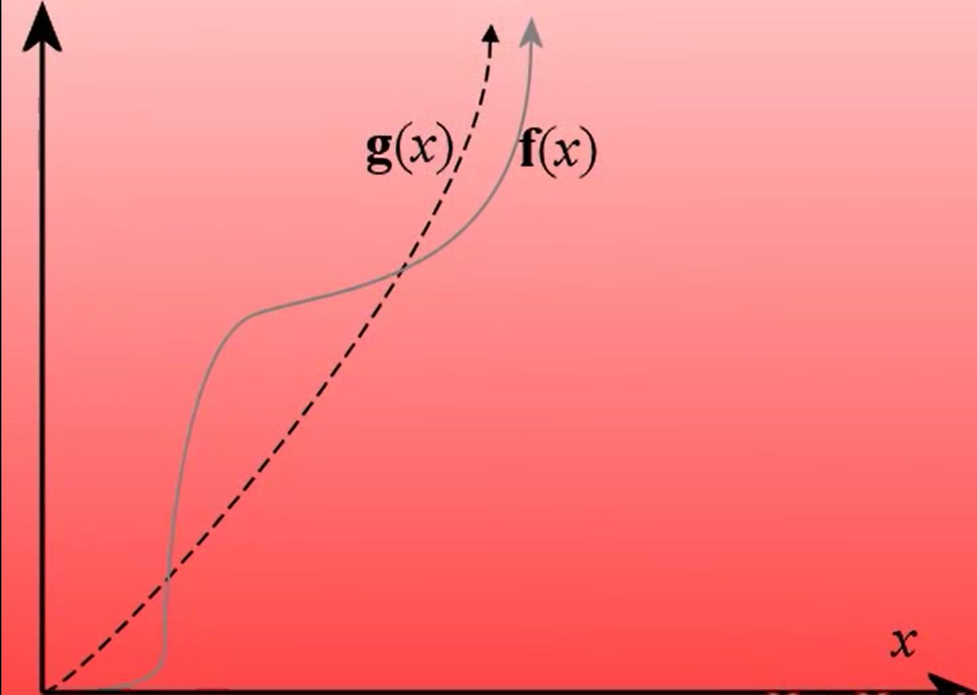

Slide 15
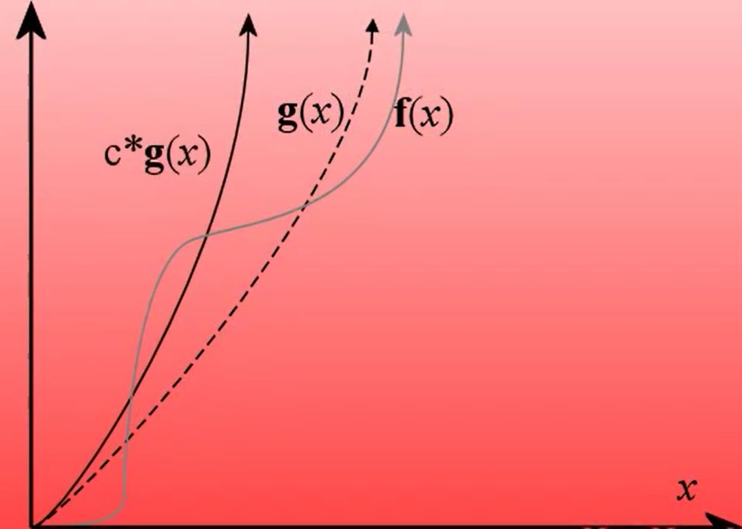

Slide 16
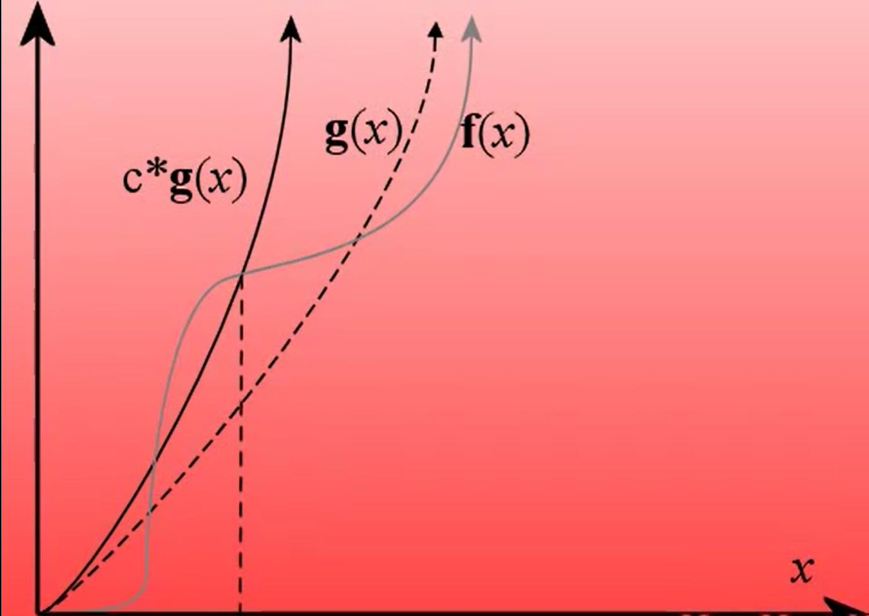
x₀

Slide 17
x₀

Slide 18
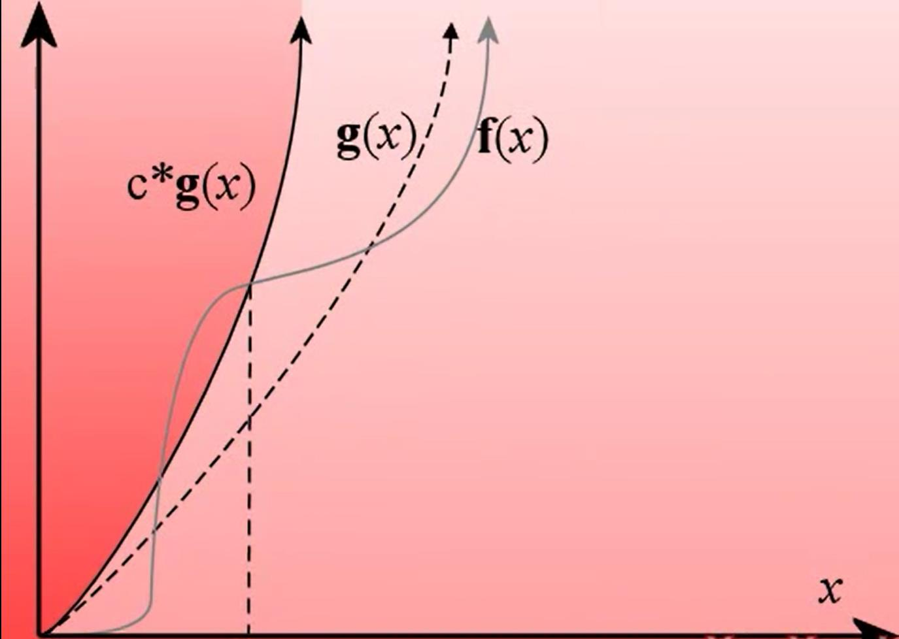
x₀

Slide 19
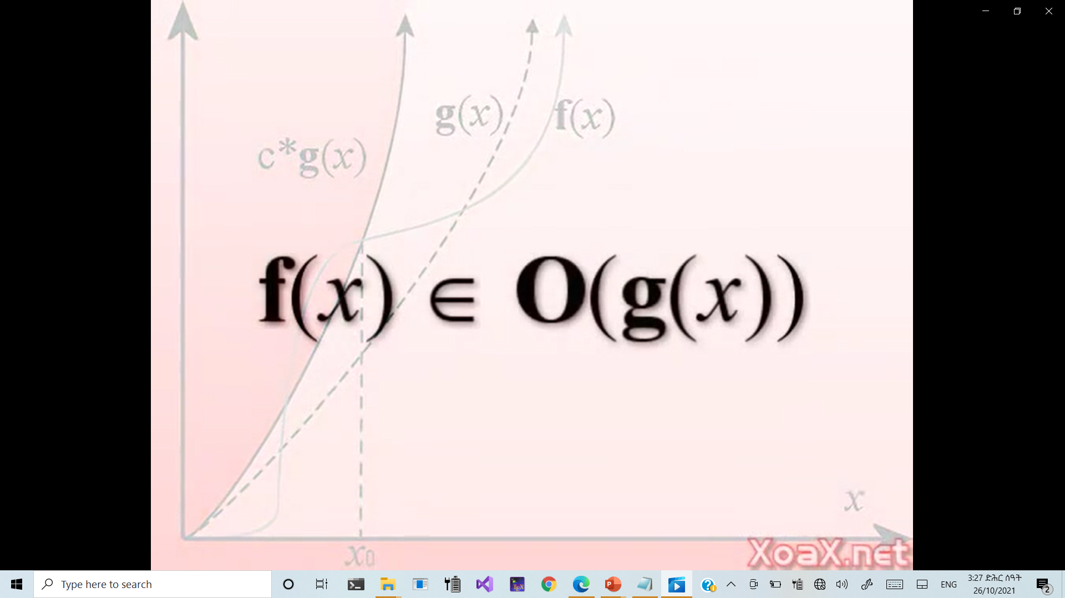
x₀

Slide 20
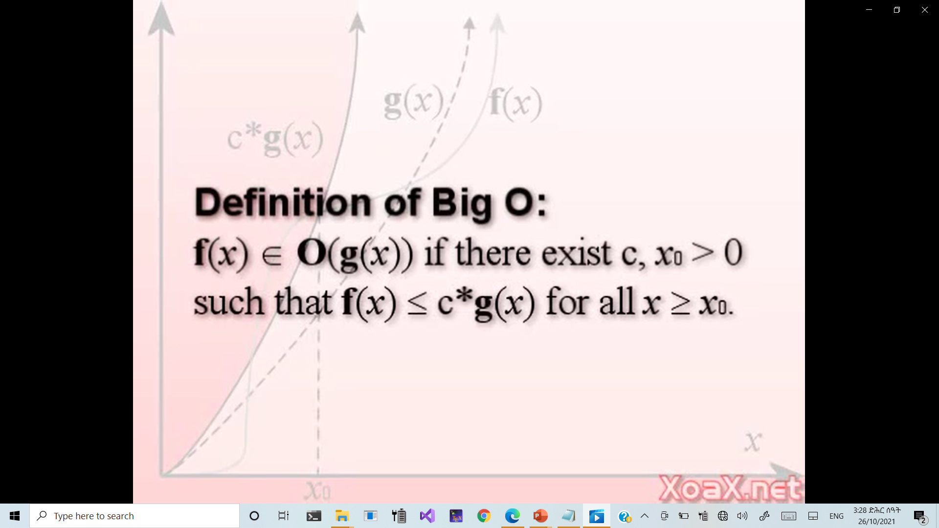
x₀

Slide 21
Ω-Omega notation
For a given function g(n), we denote by Ω(g(n)) the set of functions
We use Ω-notation to give an asymptotic lower bound on a function, to within a constant factor.
f(n)= Ω(g(n)) means that there exists some constant c s.t.
f(n) is always ≥ cg(n) for large enough n.

Slide 22
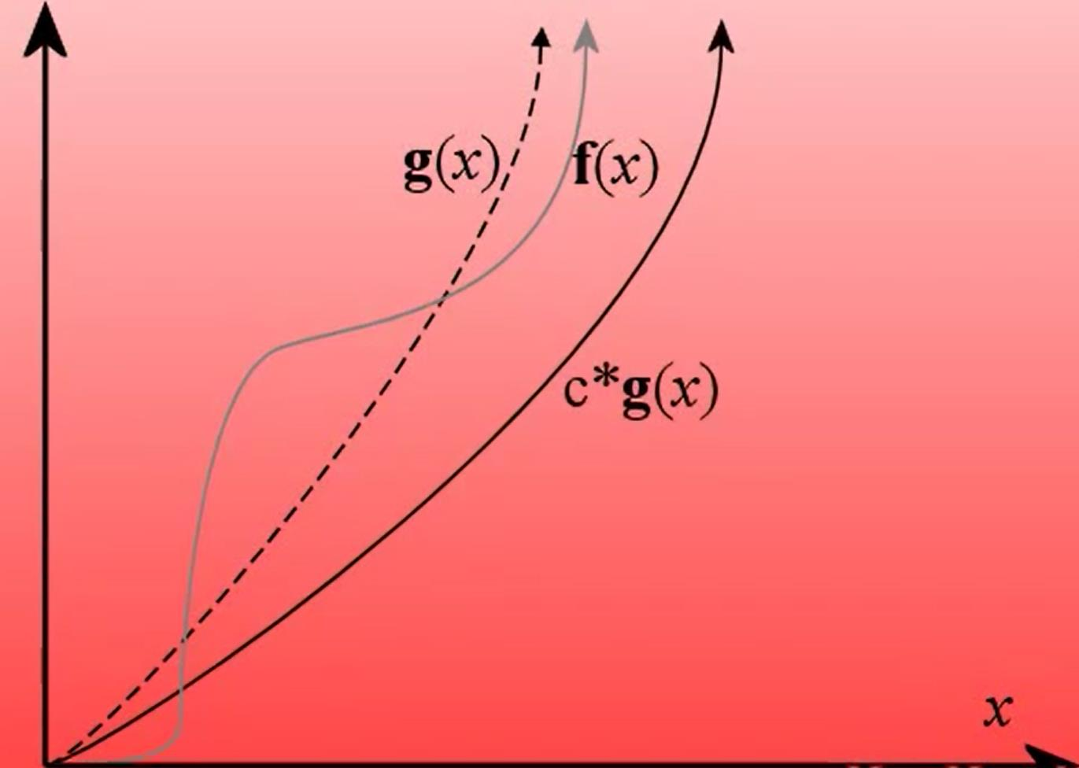

Slide 23
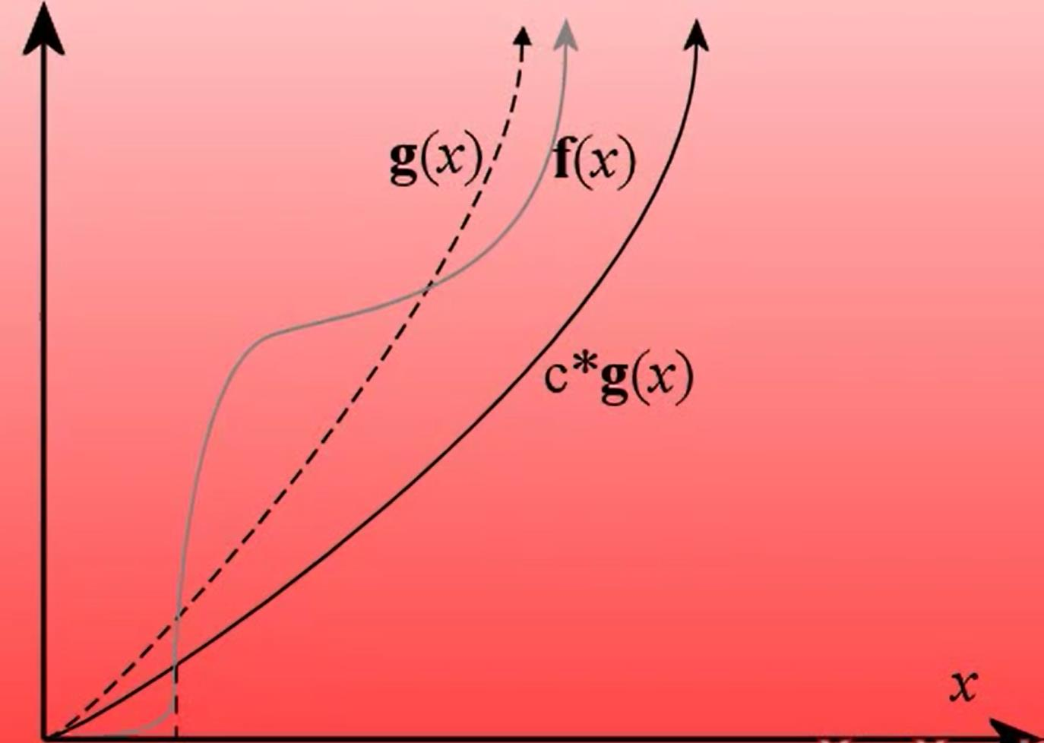
x₀

Slide 24
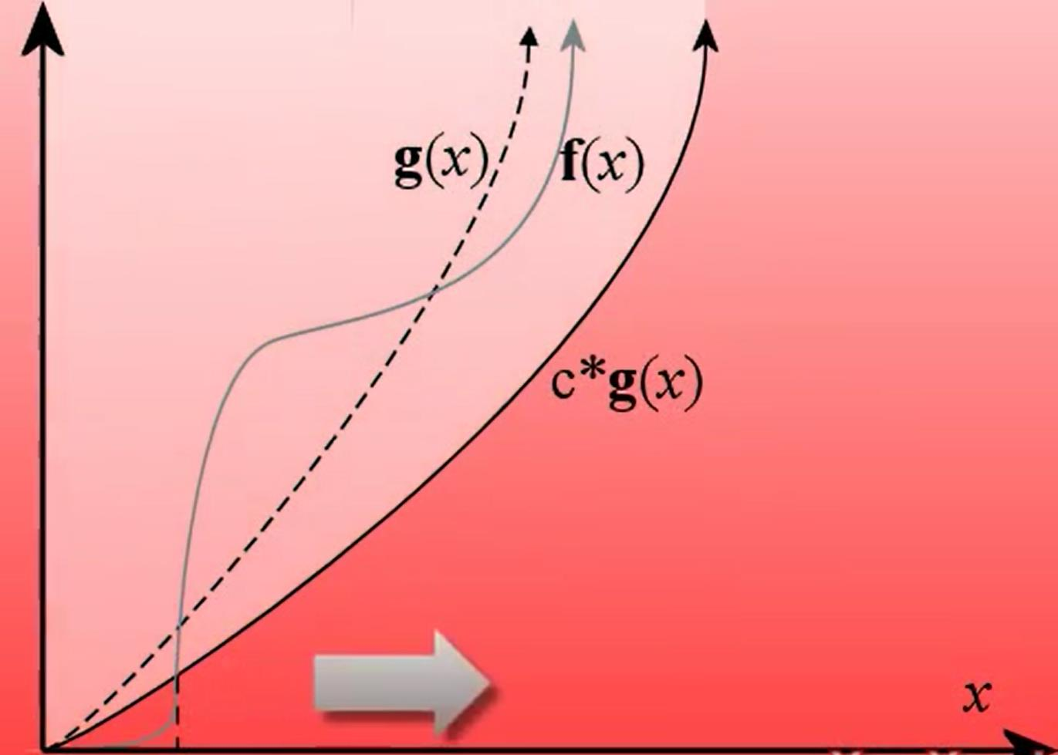
x₀

Slide 25
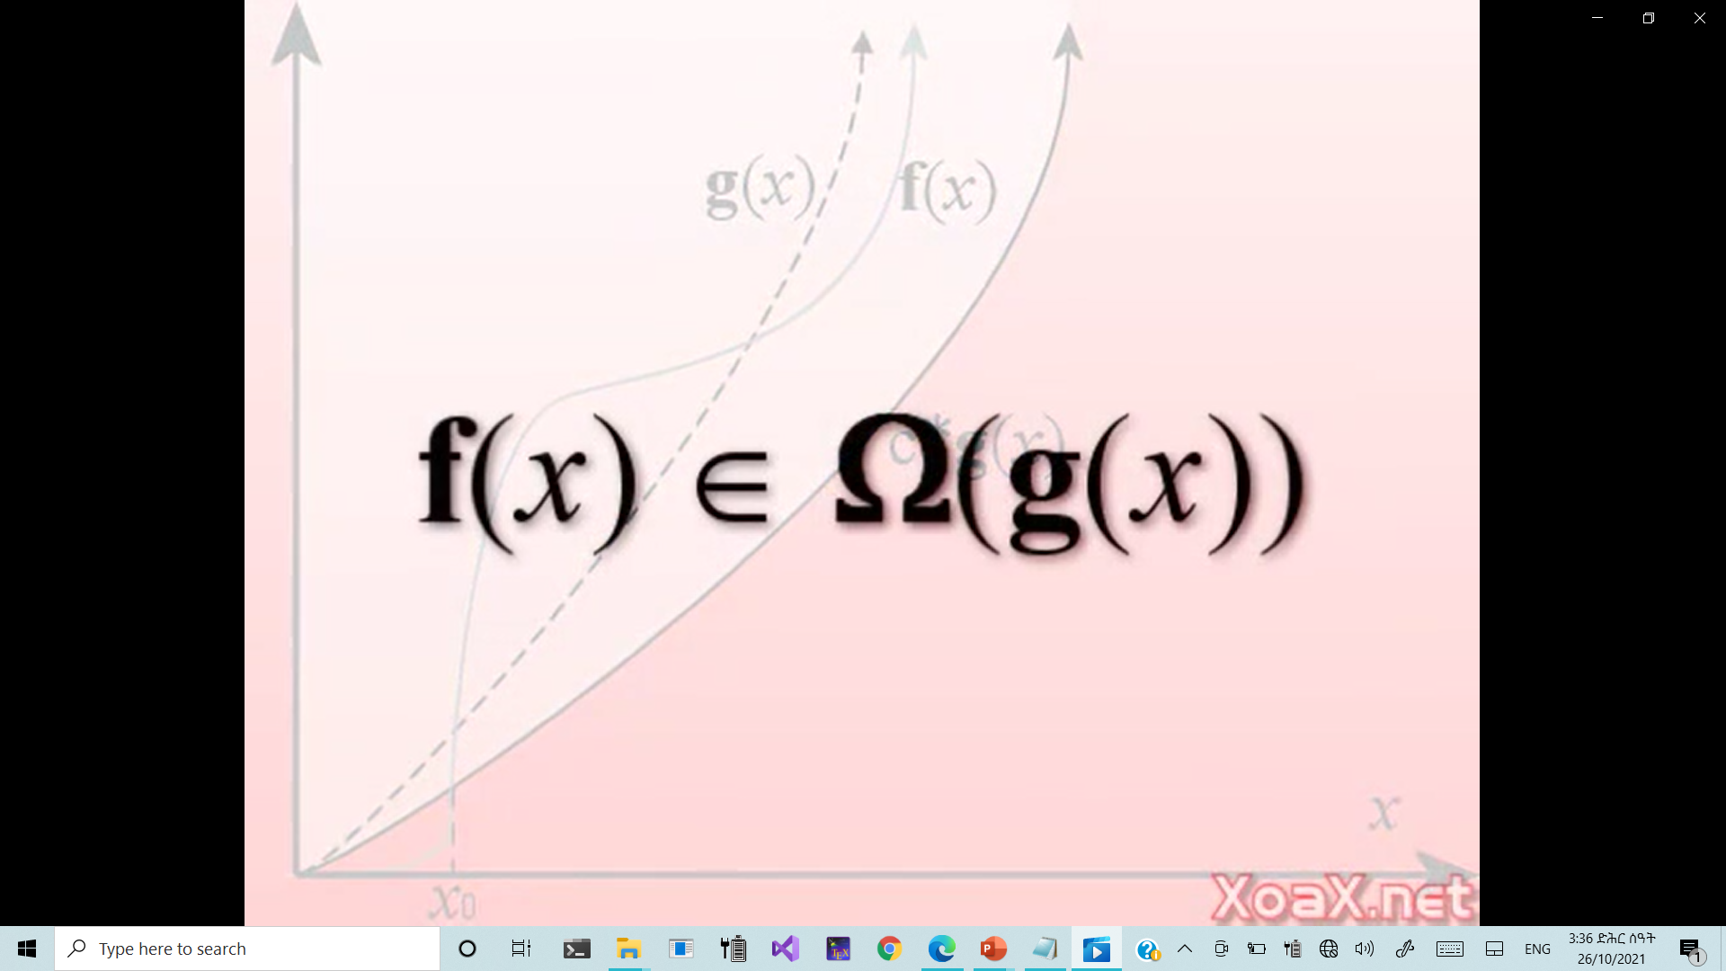
x₀

Slide 26
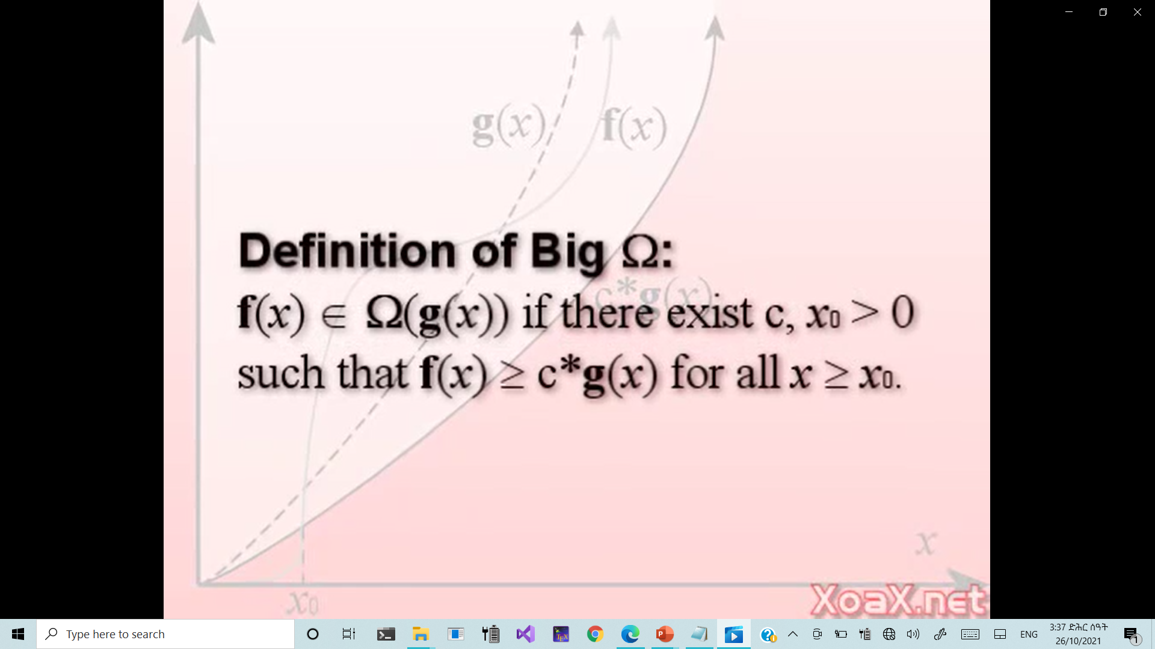
x₀

Slide 27
Θ-Theta Notation
For a given function g(n), we denote by Θ(g(n)) the set of functions
A function f(n) belongs to the set Θ(g(n)) if there exist positive constants c₁ and c₂ such that it can be “sand- wiched” between c₁g(n) and c₂g(n) for sufficienly large n.
f(n) = Θ(g(n)) means that there exists some constant c₁ and c₂ s.t. c₁g(n) ≤ f(n) ≤ c₂g(n) for large enough n.

Slide 28
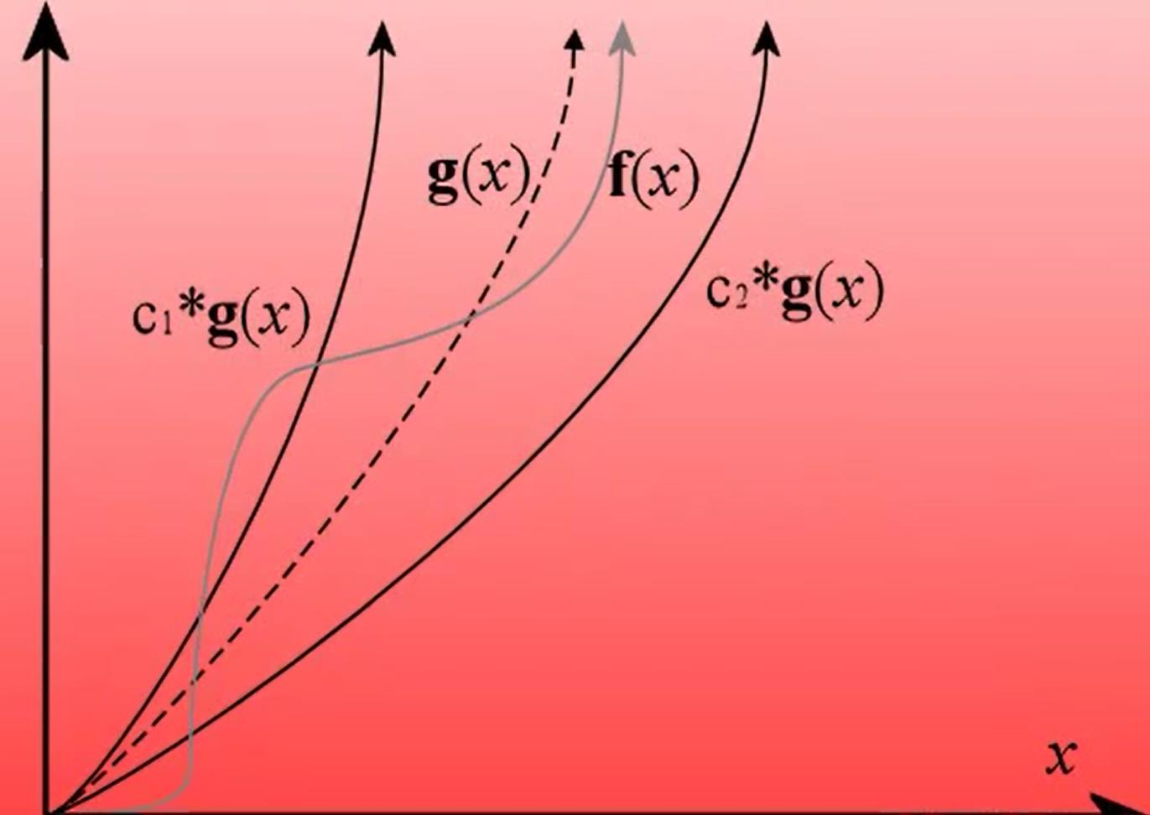

Slide 29
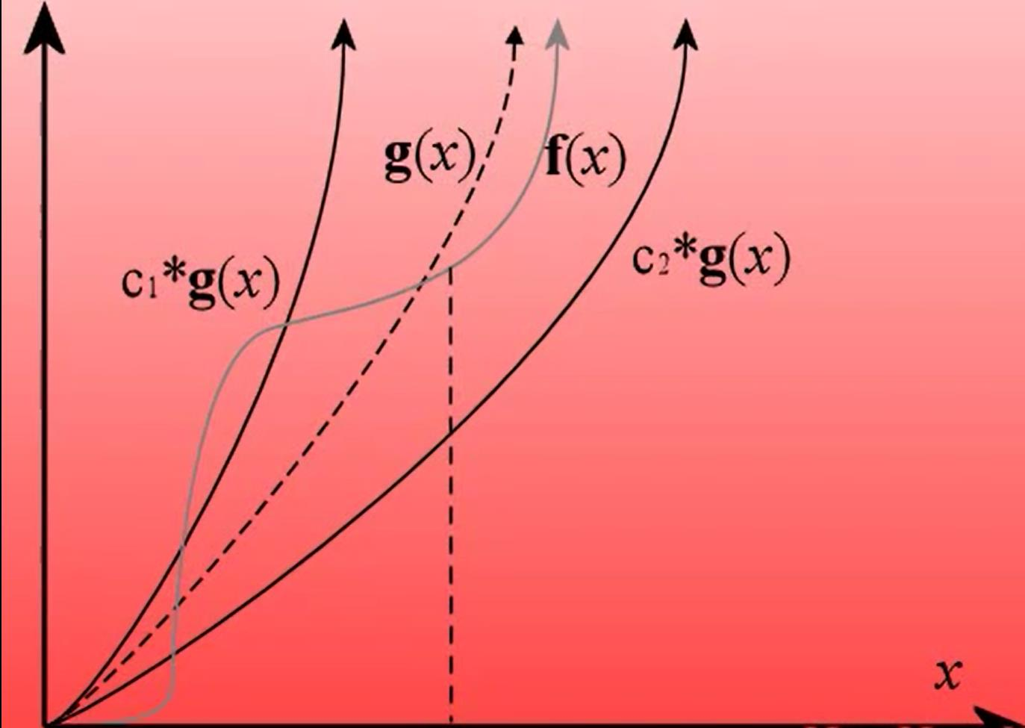
x₀

Slide 30
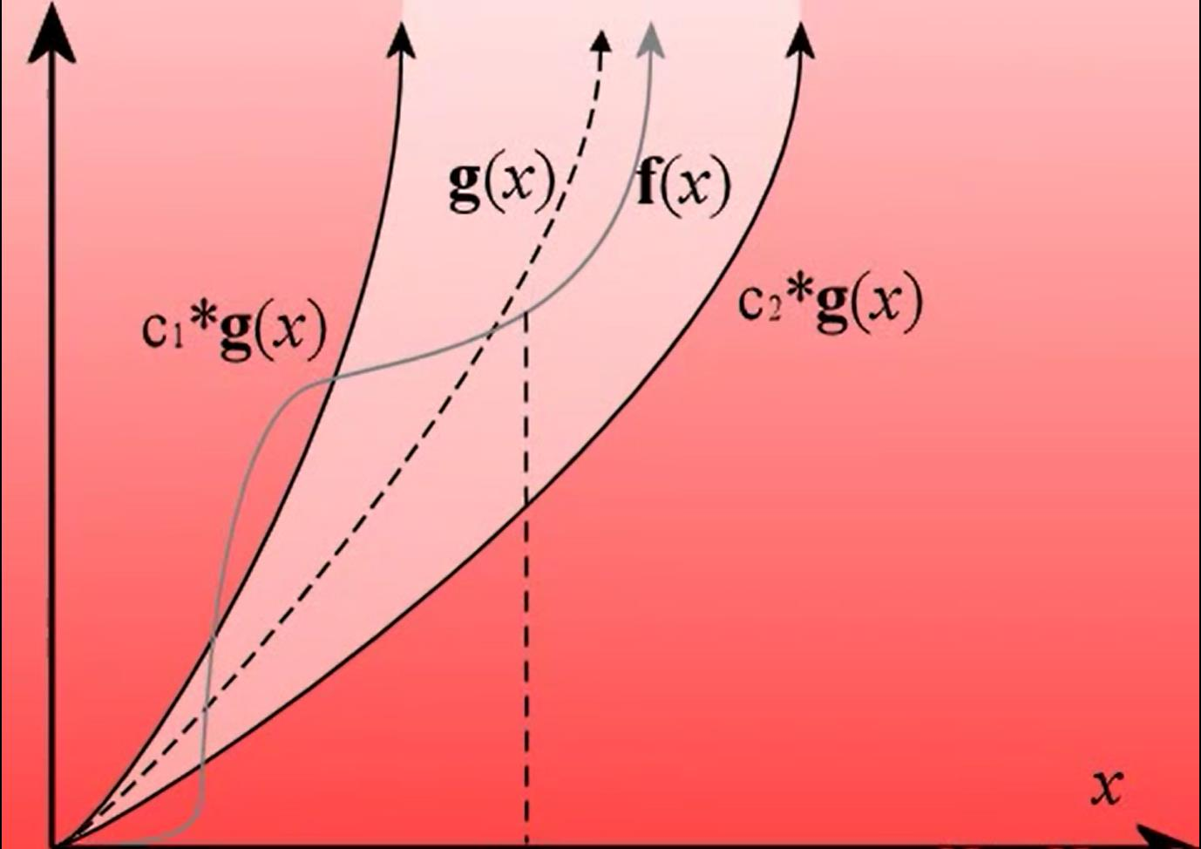
x₀

Slide 31
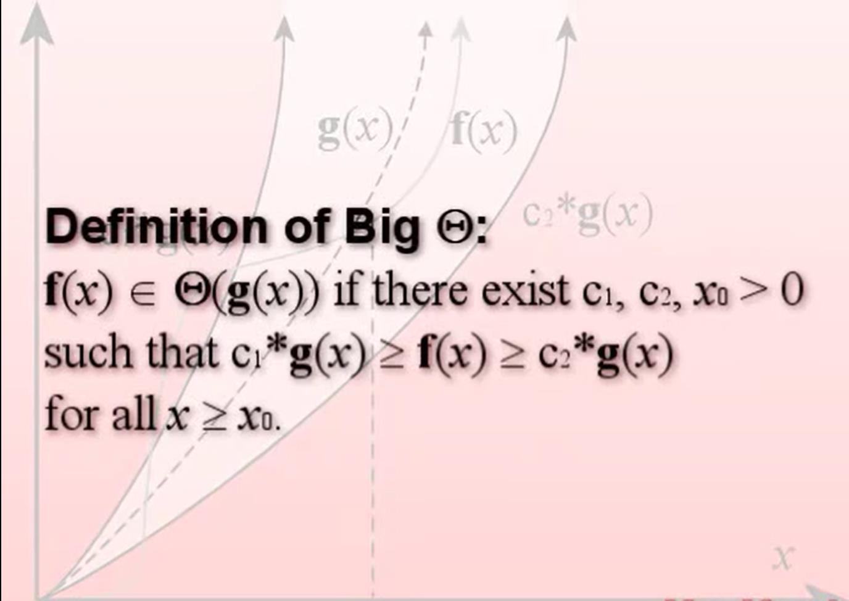
x₀

Slide 32
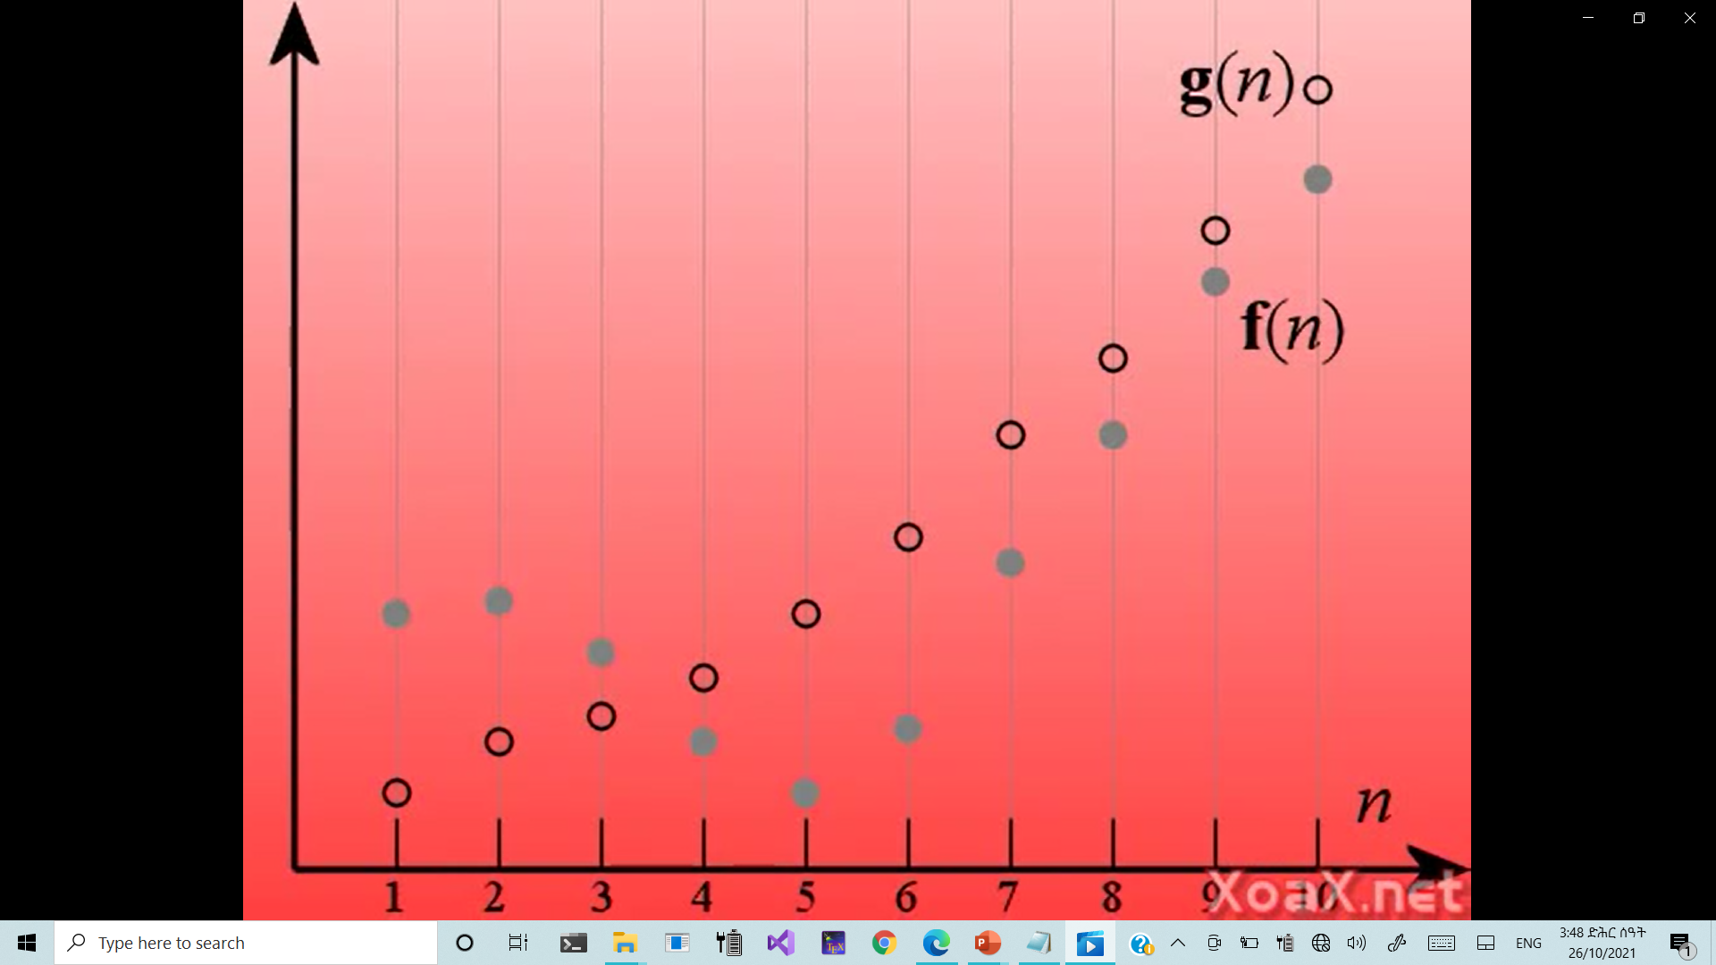

Slide 33
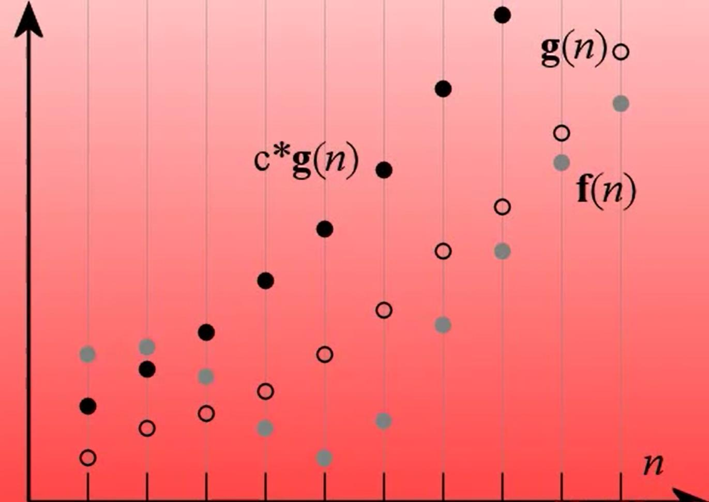

Slide 34
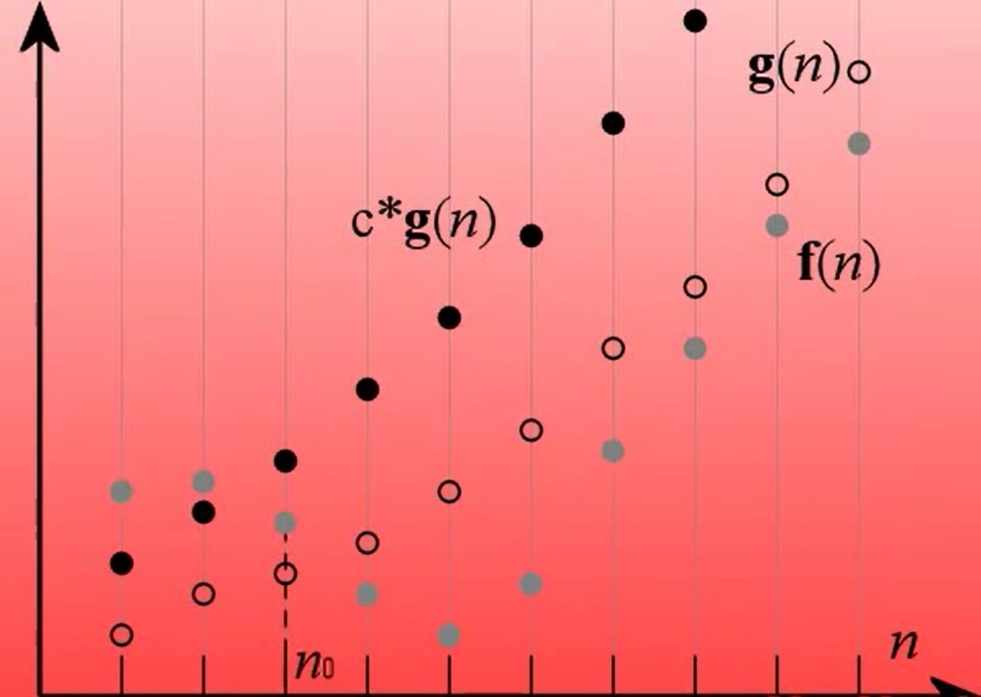

Slide 35
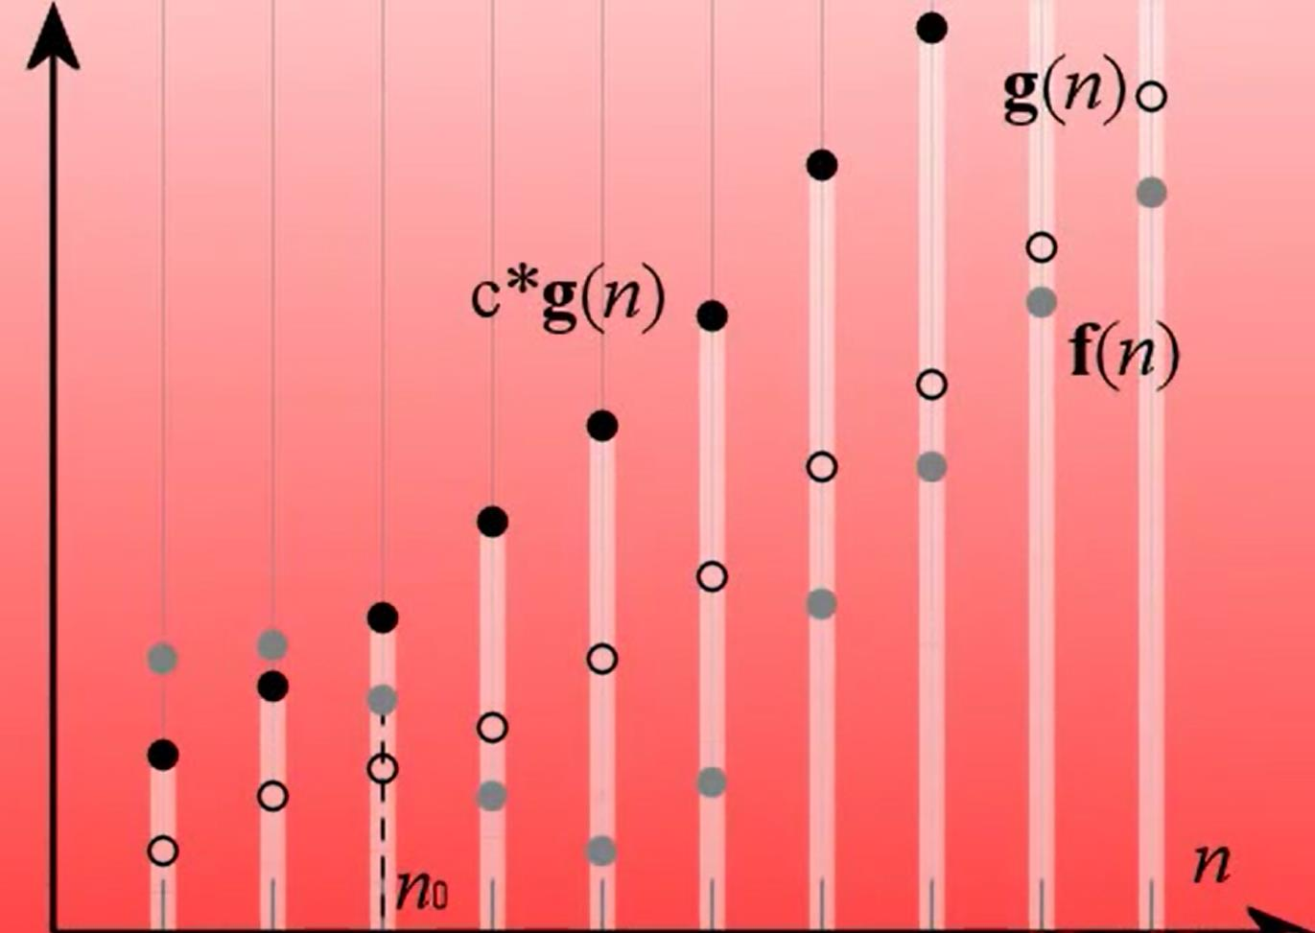

Slide 36
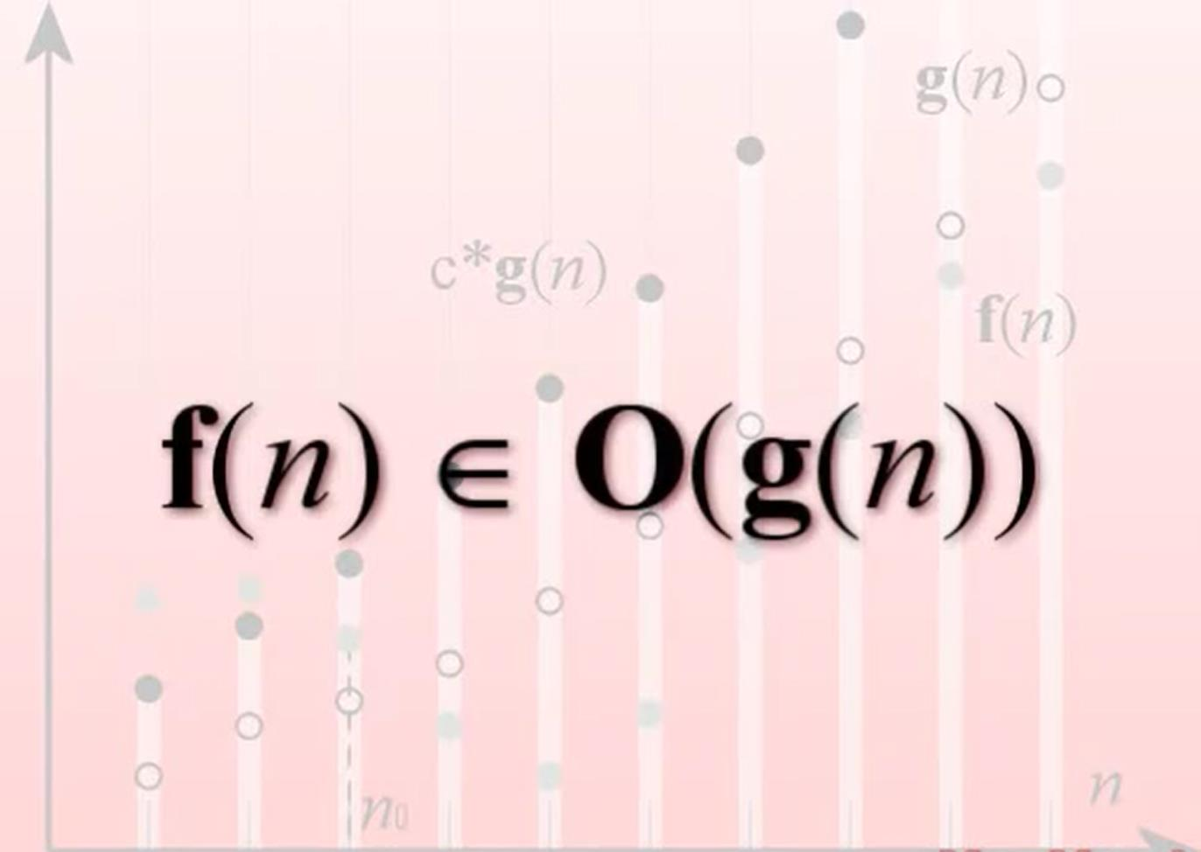

Slide 37
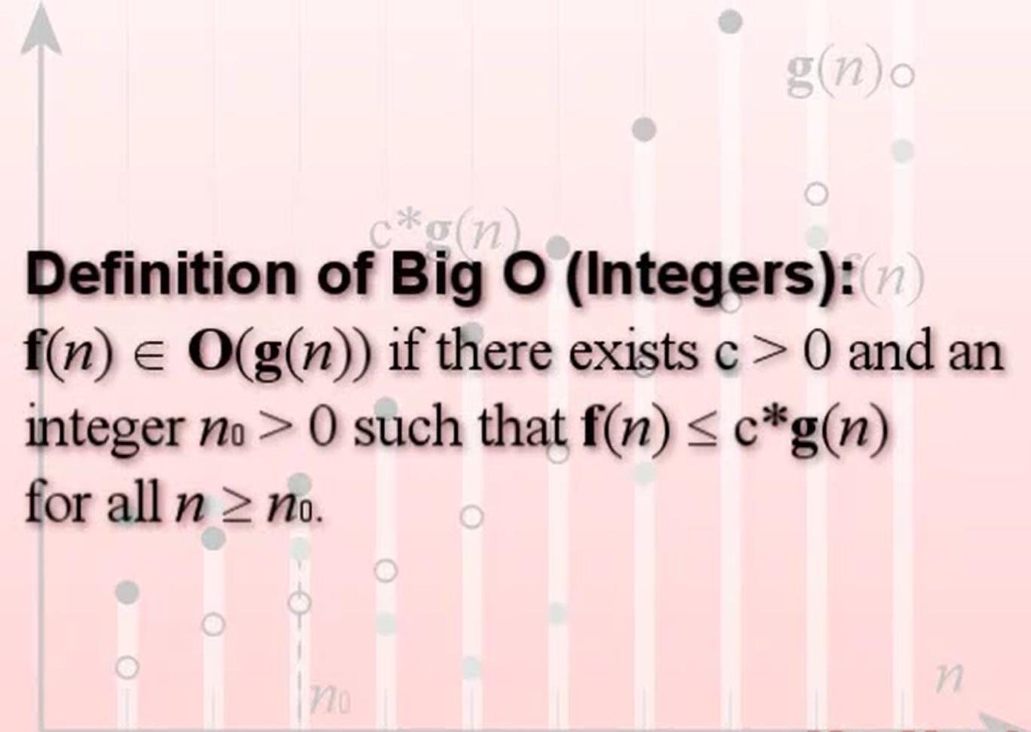

Slide 38
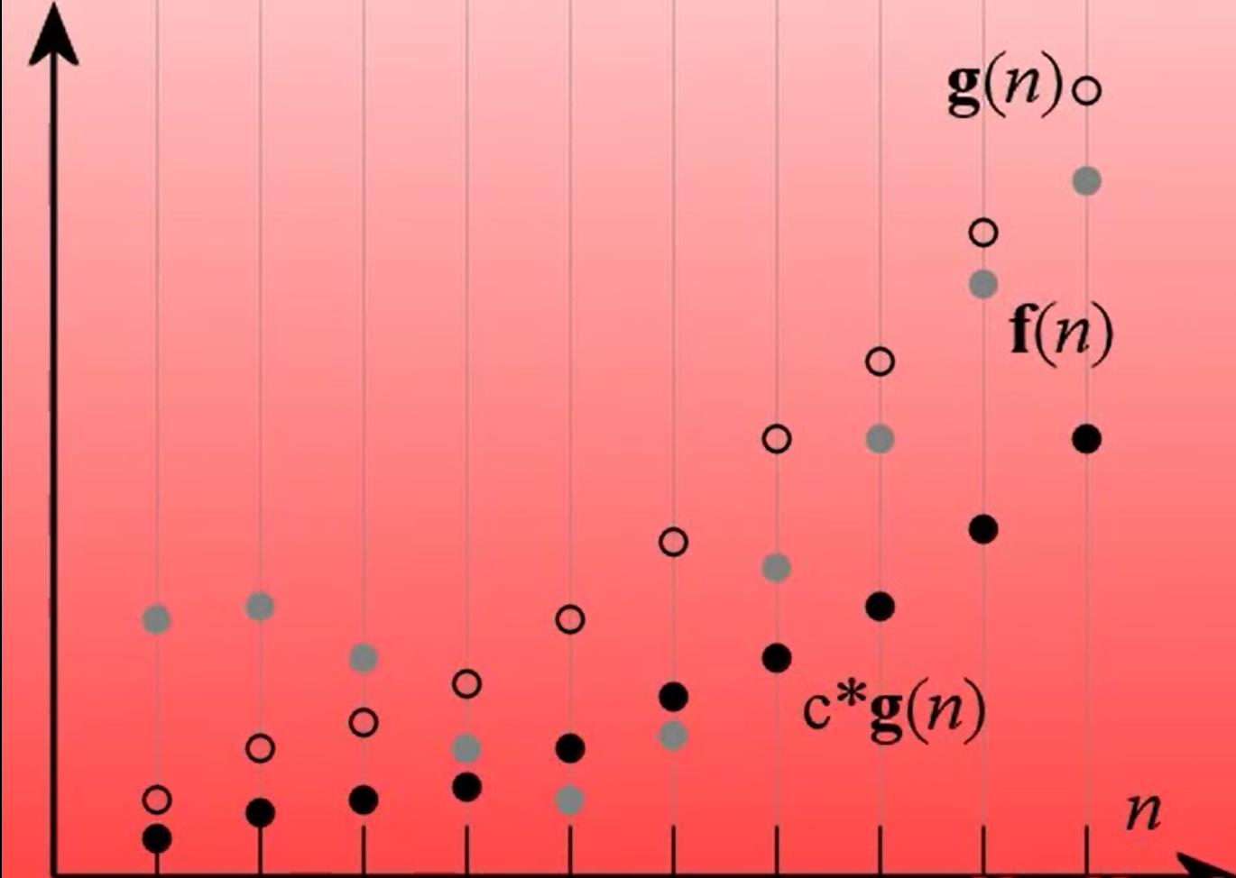

Slide 39
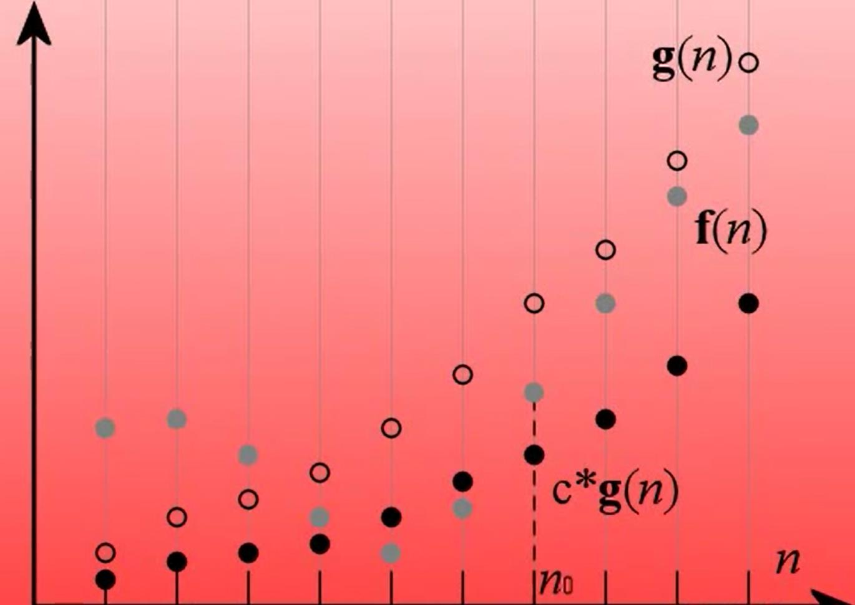

Slide 40
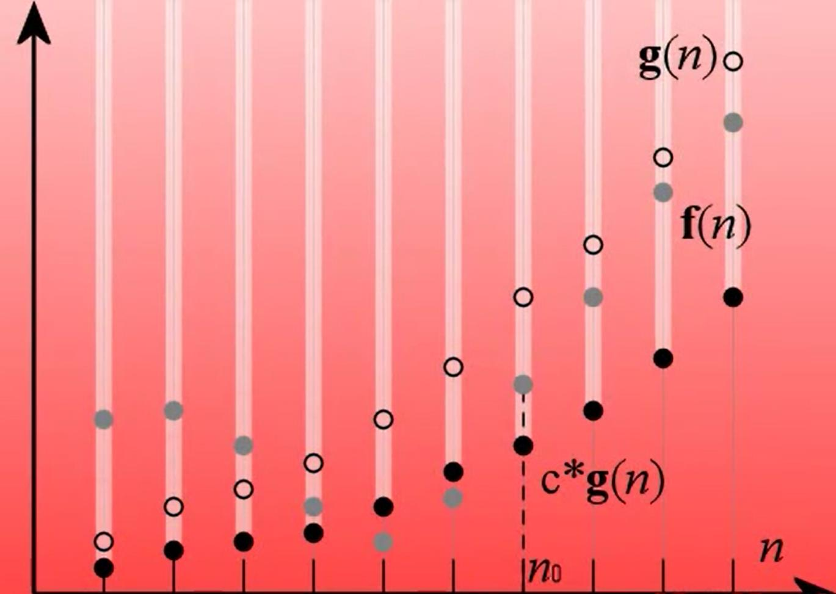

Slide 41
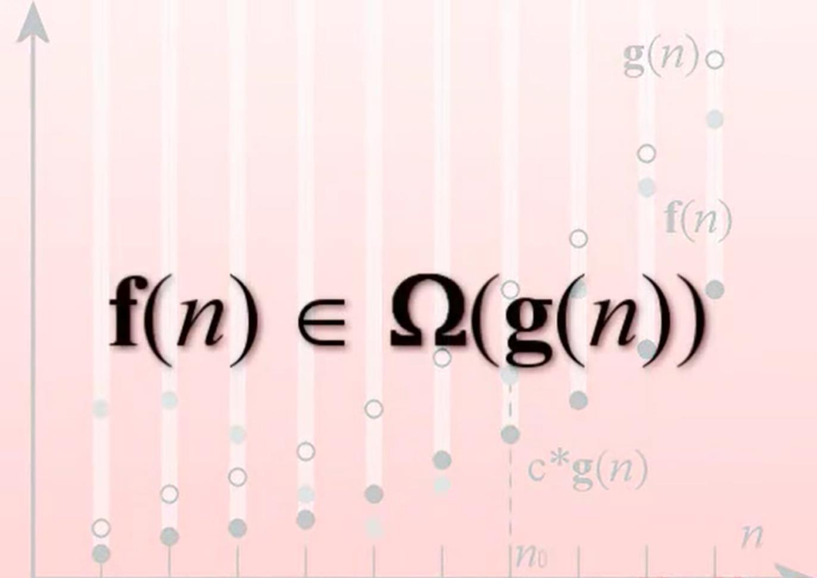

Slide 42
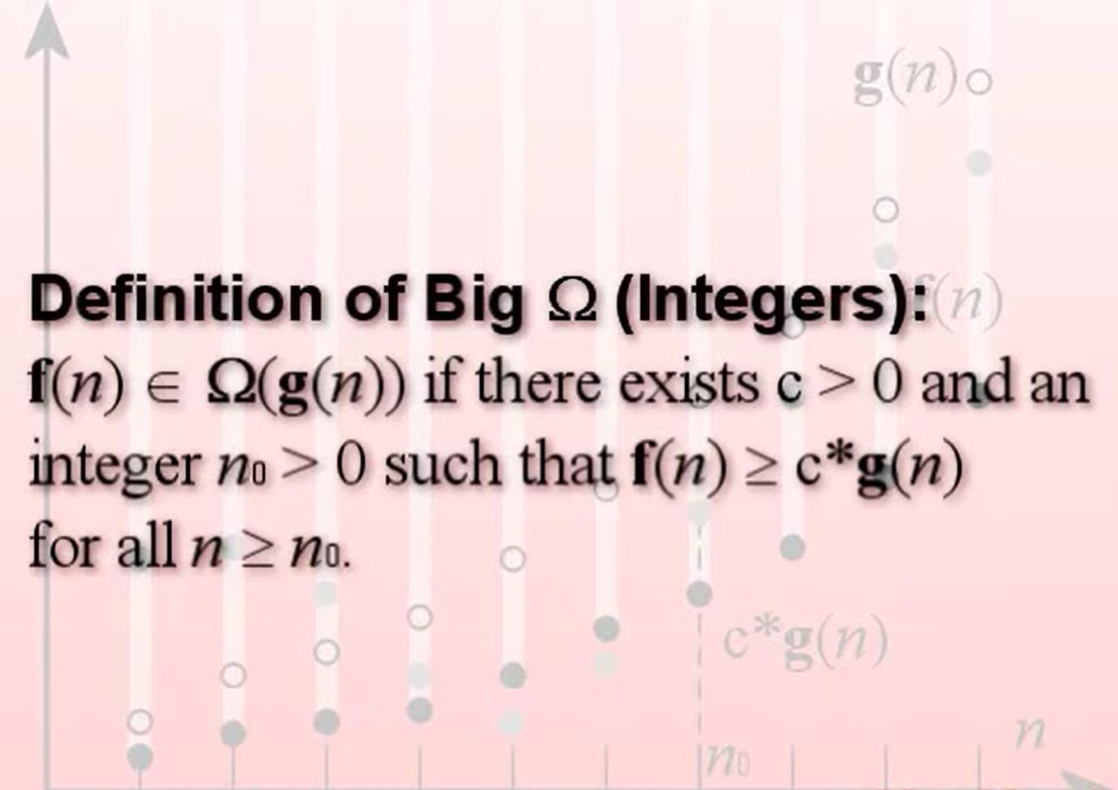

Slide 43
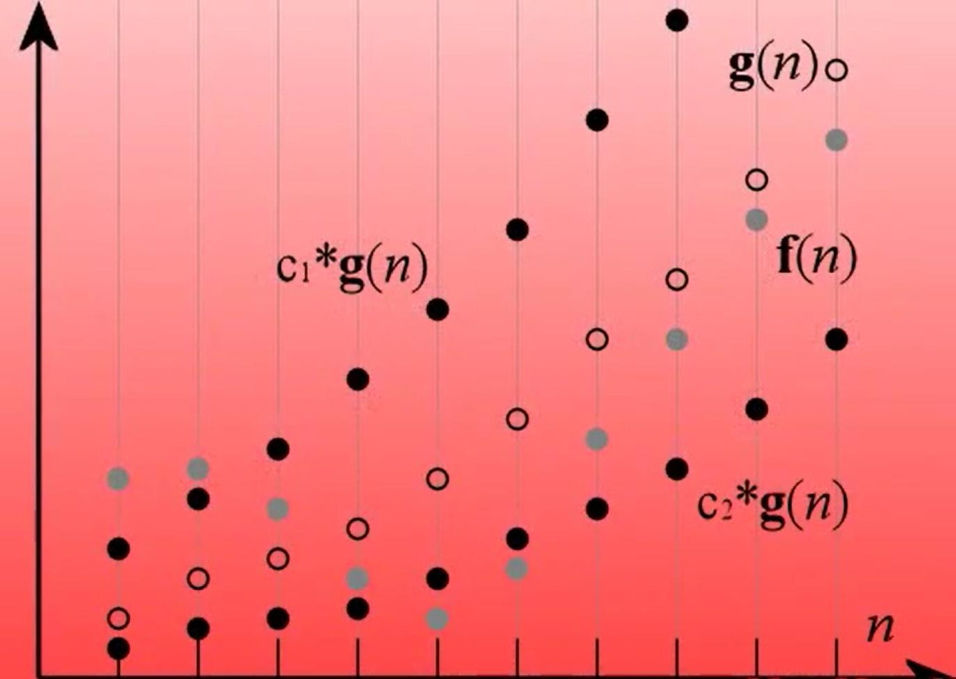

Slide 44
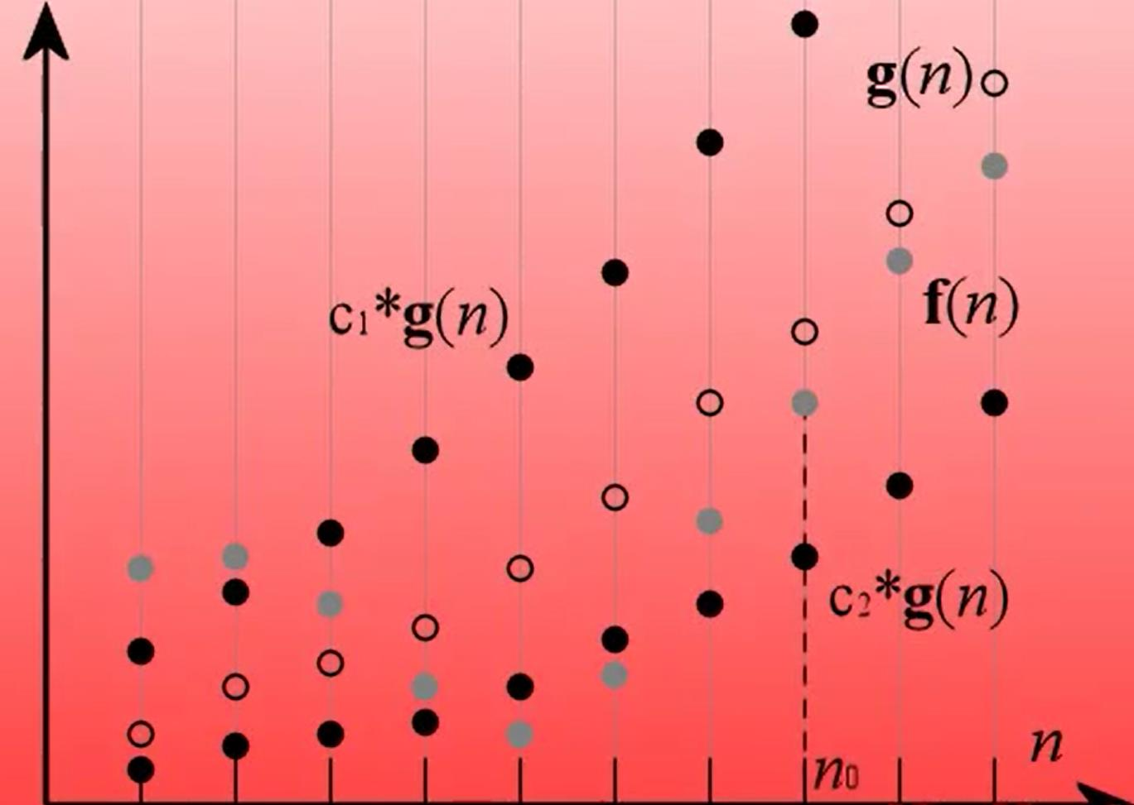

Slide 45
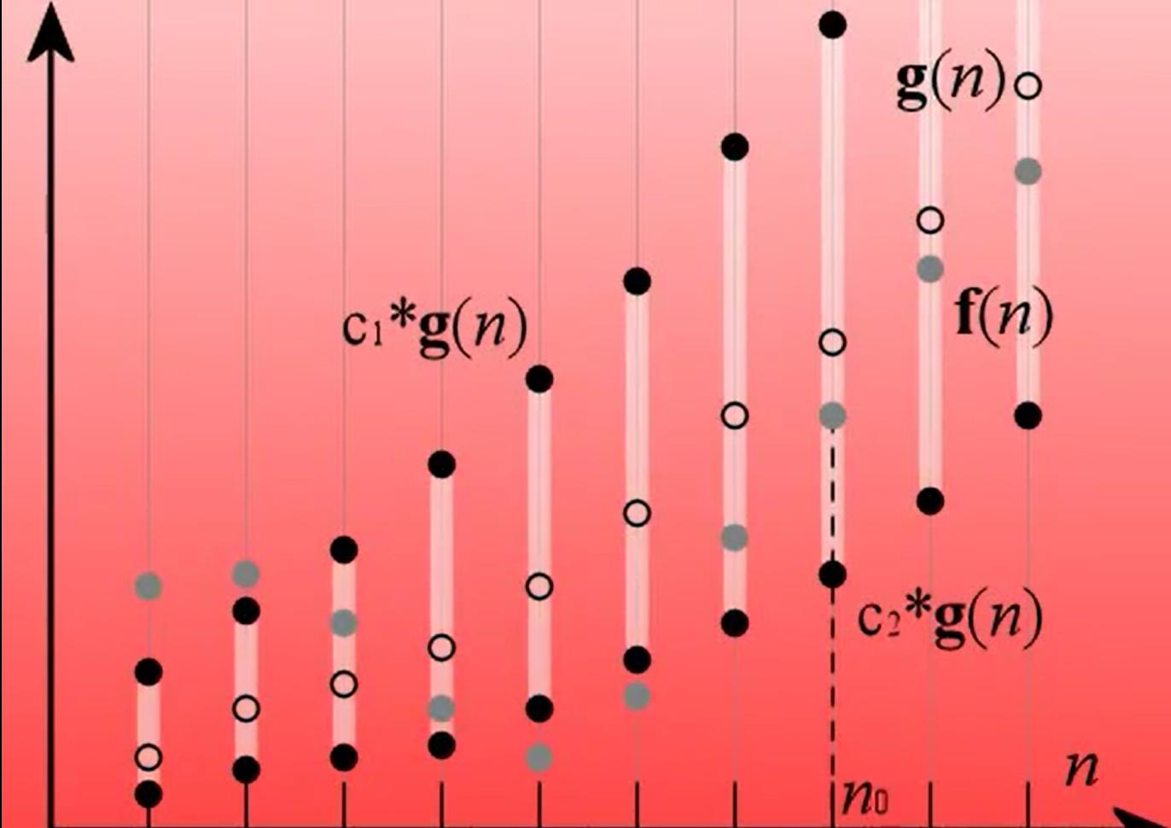

Slide 46
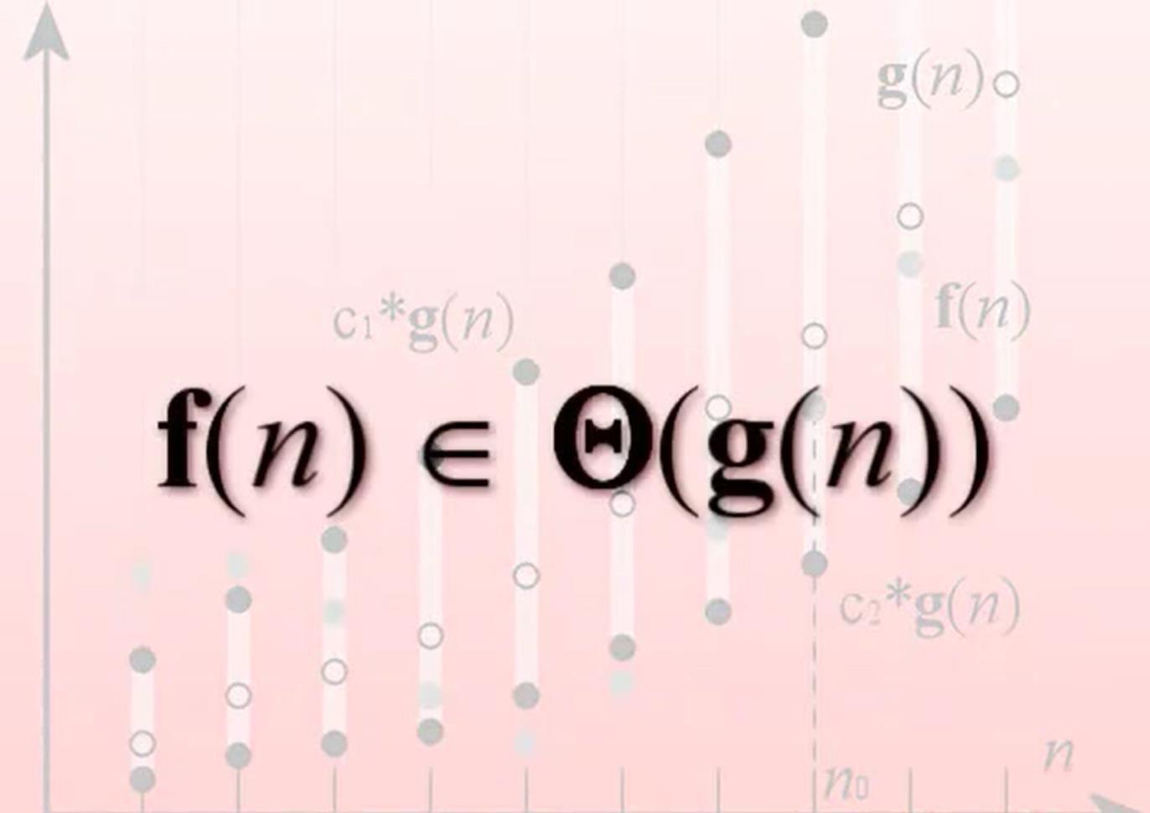

Slide 47
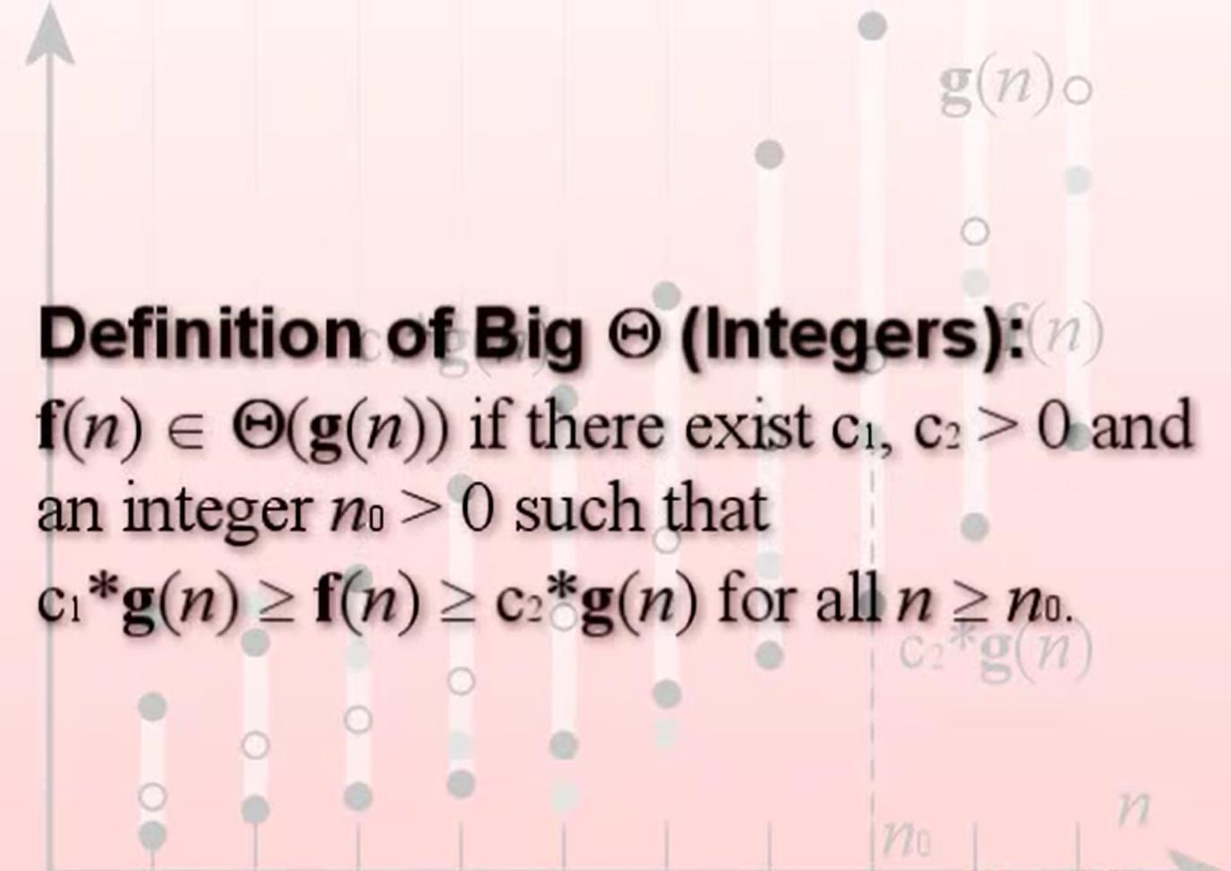

Slide 48
Asymptotic Notation in Equations
We can use asymptotic notation in equations to replace expressions containing lower-order terms.
For example,
4n³ + 3n² + 2n + 1 = 4n³ + 3n² + Θ(n)
4n³ + Θ(n²) = Θ(n³). How to interpret?
In equations, Θ(f(n)) always stands for an anonymous function g(n) Θ(f(n))
In the example above, Θ(n²) stands for 3n² + 2n + 1.

Slide 49
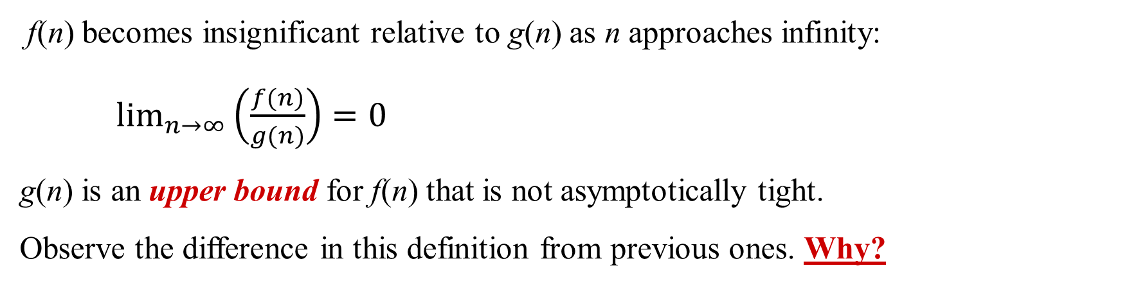
o-notation
For a given function g(n), the set little-o:
o(g(n)) = {f(n): ∀ c > 0, ∃ n₀ > 0 such that ∀ n ≥ n₀, we have 0 ≤ f(n) < cg(n)}.
f(n) becomes insignificant relative to g(n) as n approaches infinity:
$\lim_{n→∞}\left(\frac{f(n)}{g(n)}\right)=0$
g(n) is an upper bound for f(n) that is not asymptotically tight.
Observe the difference in this definition from previous ones. Why?

Slide 50
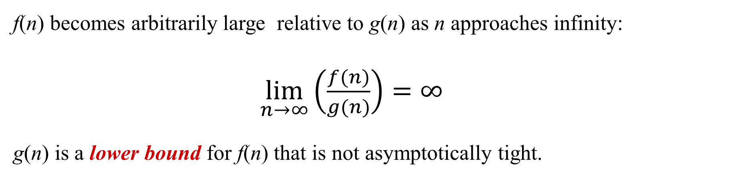
ω - notation
For a given function g(n), the set little-omega:
ω(g(n)) = {f(n): ∀ c > 0, ∃ n₀ > 0 such that ∀ n ≥ n₀, we have 0 ≤ cg(n) < f(n)}.
f(n) becomes arbitrarily large relative to g(n) as n approaches infinity:
$\lim_{n→∞}\left(\frac{f(n)}{g(n)}\right)=∞$
g(n) is a lower bound for f(n) that is not asymptotically tight.

Slide 51
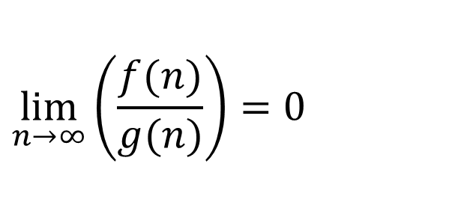
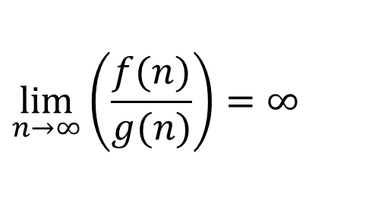
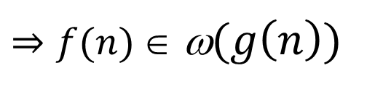
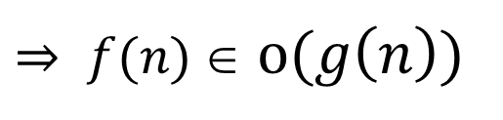
Limits
$$\lim_{n→∞}\left(\frac{f(n)}{g(n)}\right)=0$$
$⇒ f(n)$ ∈ $o(g\left(n\right))$
example: 2n = o(n²) 2n² is not o(n²)
$$\lim_{n→∞}\left(\frac{f(n)}{g(n)}\right)=∞$$
$⇒f(n)$ ∈ ω$(g\left(n\right))$

Slide 52
Comparison of Functions
f ↔ g ≈ a ↔ b
f (n) = O(g(n)) ≈ a ≤ b
f (n) = Ω(g(n)) ≈ a ≥ b
f (n) = Θ(g(n)) ≈ a = b
f (n) = o(g(n)) ≈ a < b
f (n) = w (g(n)) ≈ a > b

Slide 53
Properties
f(n) = Θ(g(n)) & g(n) = Θ(h(n)) ⇒ f(n) = Θ(h(n))
f(n) = O(g(n)) & g(n) = O(h(n)) ⇒ f(n) = O(h(n))
f(n) = Ω(g(n)) & g(n) = Ω(h(n)) ⇒ f(n) = Ω(h(n))
f(n) = o (g(n)) & g(n) = o (h(n)) ⇒ f(n) = o (h(n))
f(n) = w(g(n)) & g(n) = w(h(n)) ⇒ f(n) = w(h(n))
Transitivity
f(n) = Θ(f(n))
f(n) = O(f(n))
f(n) = Ω(f(n))
Reflexivity

Slide 54
Properties
Symmetry
f(n) = Θ(g(n)) iff g(n) = Θ(f(n))
Complementarity
f(n) = O(g(n)) iff g(n) = Ω(f(n))
f(n) = o(g(n)) iff g(n) = w((f(n))

Slide 55
Monotonicity
f(n) is
monotonically increasing if m ≤ n ⇒ f(m) ≤ f(n).
monotonically decreasing if m ≥ n ⇒ f(m) ≥ f(n).
strictly increasing if m < n ⇒ f(m) < f(n).
strictly decreasing if m > n ⇒ f(m) > f(n).

Slide 56
Exponentials
Useful Identities:
Exponentials and polynomials

Slide 57
Logarithms and exponentials – Bases
If the base of a logarithm is changed from one constant to another, the value is altered by a constant factor.
Ex: log₁₀ n * log₂10 = log₂ n.
Base of logarithm is not an issue in asymptotic notation.
Exponentials with different bases differ by a exponential factor (not a constant factor).
Ex: 2^{n} = (2/3)^{n}*3^{n}.

Slide 58
Logarithms
x = log_{b}a is the exponent for a = b^{x}.
Natural log: ln a = log_{e}a
Binary log: lg a = log₂a
lg²a = (lg a)²
lg lg a = lg (lg a)

Slide 59
Logarithms and exponentials – Bases
If the base of a logarithm is changed from one constant to another, the value is altered by a constant factor.
Ex: log₁₀ n * log₂10 = log₂ n.
Base of logarithm is not an issue in asymptotic notation.
Exponentials with different bases differ by a exponential factor (not a constant factor).
Ex: 2^{n} = (2/3)^{n}*3^{n}.

Slide 60
Polylogarithms
For a ³ 0, b > 0, lim _{n→∞} ( lgª n / n^{b} ) = 0, so lgª n = o(n^{b}), and n^{b} = w(lgª n )
Prove using L’Hopital’s rule repeatedly
lg(n!) = Θ(n lg n)
Prove using Stirling’s approximation (in the text) for lg(n!).

Slide 61
Exercise: Express functions in A in asymptotic notation using functions in B.
A B
5n² + 100n 3n² + 2
A ∈ Θ(B)
A ∈ Θ(n²), n² ∈ Θ(B) ⇒ A ∈ Θ(B)
log₃(n²) log₂(n³)
A ∈ Θ(B)
log_{b}a = log_{c}a / log_{c}b; A = 2lgn / lg3, B = 3lgn, A/B =2/(3lg3)
n^{lg4} 3^{lg n}
A ∈ ω(B)
a^{log b} = b^{log a}; B =3^{lg n}=n^{lg 3}; A/B =n^{lg(4/3)} → ∞ as n→∞
lg²n n^{1/2}
A ∈ ο (B)
lim ( lgª n / n^{b} ) = 0 (here a = 2 and b = 1/2) ⇒ A ∈ ο (B)
^{n→∞}

Slide 62
Bubble Sort: Example
5 | 1 | 4 | 2 | 8
n = 5
5 | 1 | 4 | 2 | 8
1 | 5 | 4 | 2 | 8
4
1 | 5 | 4 | 2 | 8
1 | 4 | 5 | 2 | 8
1 | 4 | 5 | 2 | 8
1 | 4 | 2 | 5 | 8
n-1
1 | 4 | 2 | 5 | 8
1 | 4 | 2 | 5 | 8
1 | 4 | 2 | 5 | 8
1 | 4 | 2 | 5 | 8
3
1 | 4 | 2 | 5 | 8
1 | 2 | 4 | 5 | 8
n-2
1 | 2 | 4 | 5 | 8
1 | 2 | 4 | 5 | 8
1 | 2 | 4 | 5 | 8
1 | 2 | 4 | 5 | 8
2
n-3
1 | 2 | 4 | 5 | 8
1 | 2 | 4 | 5 | 8
1➔ n-4
1 | 2 | 4 | 5 | 8
1 | 2 | 4 | 5 | 8

Slide 63
Analyzing Bubble Sort
i
i
i
i
5 | 1 | 4 | 2 | 8
1 | 5 | 4 | 2 | 8
for (i = ; ; )
for (j = 0; j < i ; j++)
if (a[j] < a[j+1])
swap a[j] and a[j+1]
for (i = n-1 ; ; )
for (j = 0; j < i ; j++)
if (a[j] < a[j+1])
swap a[j] and a[j+1]
for (i = n-1 ; i > 0 ; i--)
for (j = 0; j < i ; j++)
if (a[j] < a[j+1])
swap a[j] and a[j+1]
1 | 4 | 5 | 2 | 8
1 | 4 | 2 | 5 | 8
1 | 4 | 2 | 5 | 8
1 | 4 | 2 | 5 | 8
1 | 2 | 4 | 5 | 8
1 | 2 | 4 | 5 | 8
5 | 1 | 4 | 2 | 8
1 | 2 | 4 | 5 | 8
j
j
j
j

Slide 64
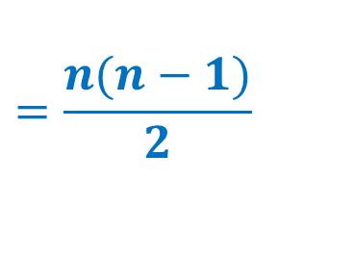
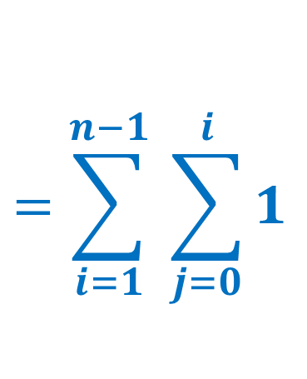
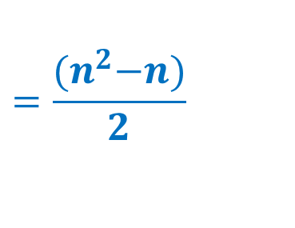
Analyzing Bubble Sort
for (i = n-1 ; i > 0 ; i--)
for (j = 0; j < i ; j++)
if (a[j] < a[j+1])
swap a[j] and a[j+1]
$$=\sum_{i=1}^{n−1}{ \sum_{j=0}^{i}{1}}$$
= (n – 1) + (n – 2) + … + 2 + 1
$$=\frac{{(n}^{2}−n)}{2}$$
$$=\frac{n(n−1)}{2}$$

Slide 65
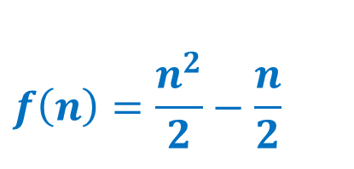
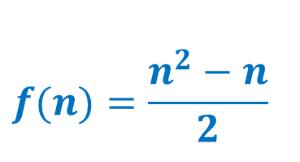
Analyzing Bubble Sort
for (i = n-1 ; i > 0 ; i--)
for (j = 0; j < i ; j++)
if (a[j] < a[j+1])
swap a[j] and a[j+1]
$$f(n)=\frac{n^{2}−n}{2}$$
$$f\left(n\right)=\frac{n^{2}}{2}−\frac{n}{2}$$
The running time of Bubble Sort is: Θ(n²)
Yes / No ?

Slide 66
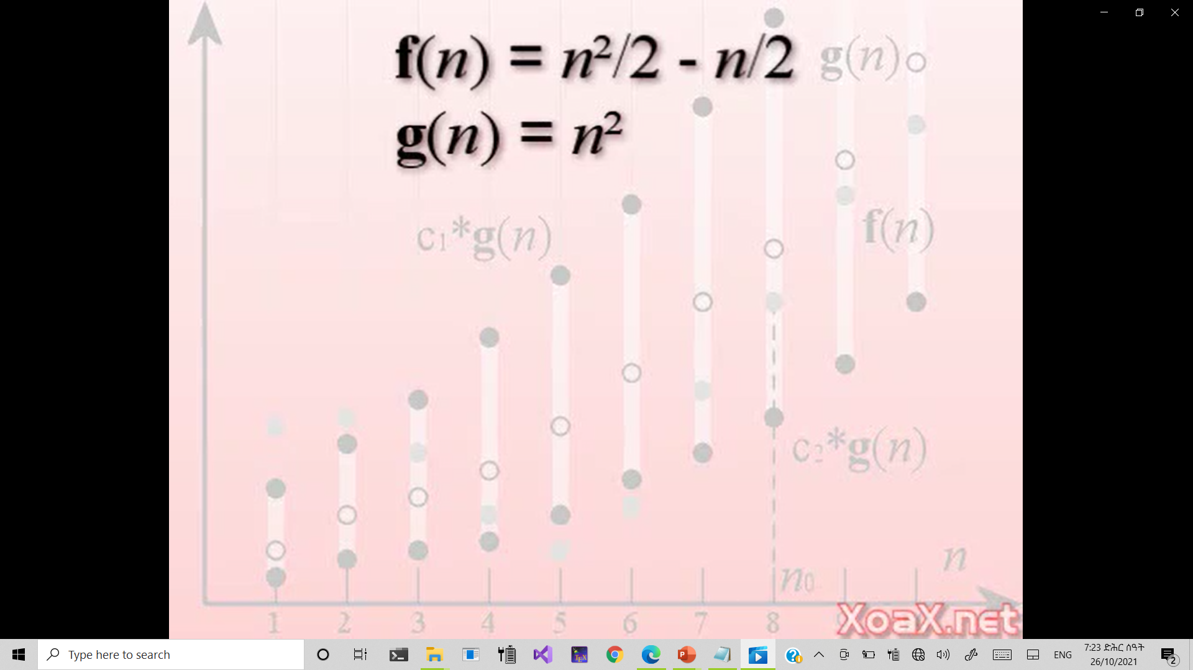
Analyzing Bubble Sort
We need to find c₁ and c₂ where
c₁g(n) ≥ f(n) ≥ c₂g(n)
for all n > n₀

Slide 67
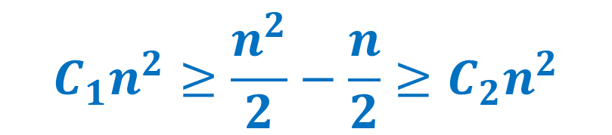

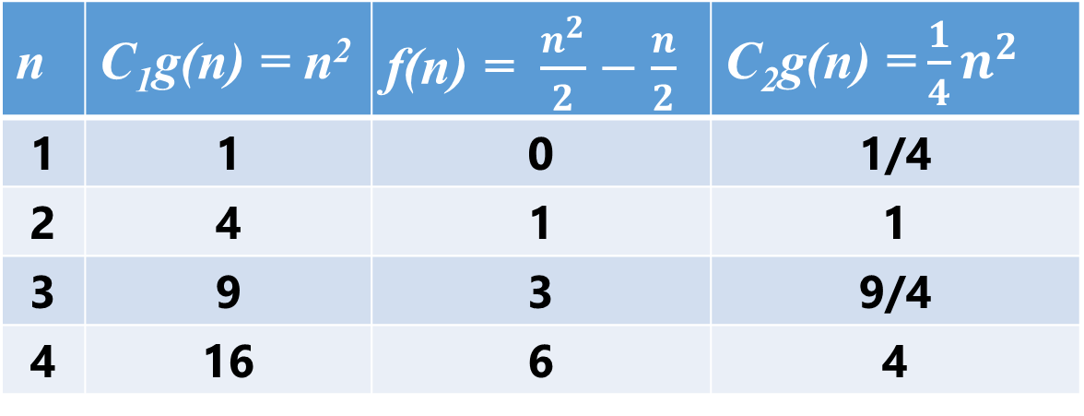
Analyzing Bubble Sort
We need to find C₁ and C₂ where C₁g(n) ≥ f(n) ≥ C₂g(n) for all n > n₀
$$C_{1}n^{2}≥\frac{n^{2}}{2}−\frac{n}{2}≥C_{2}n^{2}$$
$${Any C}_{1}≥\frac{1}{2} and{ C}_{2}<\frac{1}{2} works. We choose{ C}_{1}=1 and{ C}_{2}=\frac{1}{4}$$
n | C₁g(n) = n² | f(n) = $\frac{n^{2}}{2}−\frac{n}{2}$ | C₂g(n) =$\frac{1}{4}n^{2}$
1 | 1 | 0 | 1/4
2 | 4 | 1 | 1
3 | 9 | 3 | 9/4
4 | 16 | 6 | 4
$$n_{0}=2$$

Slide 68
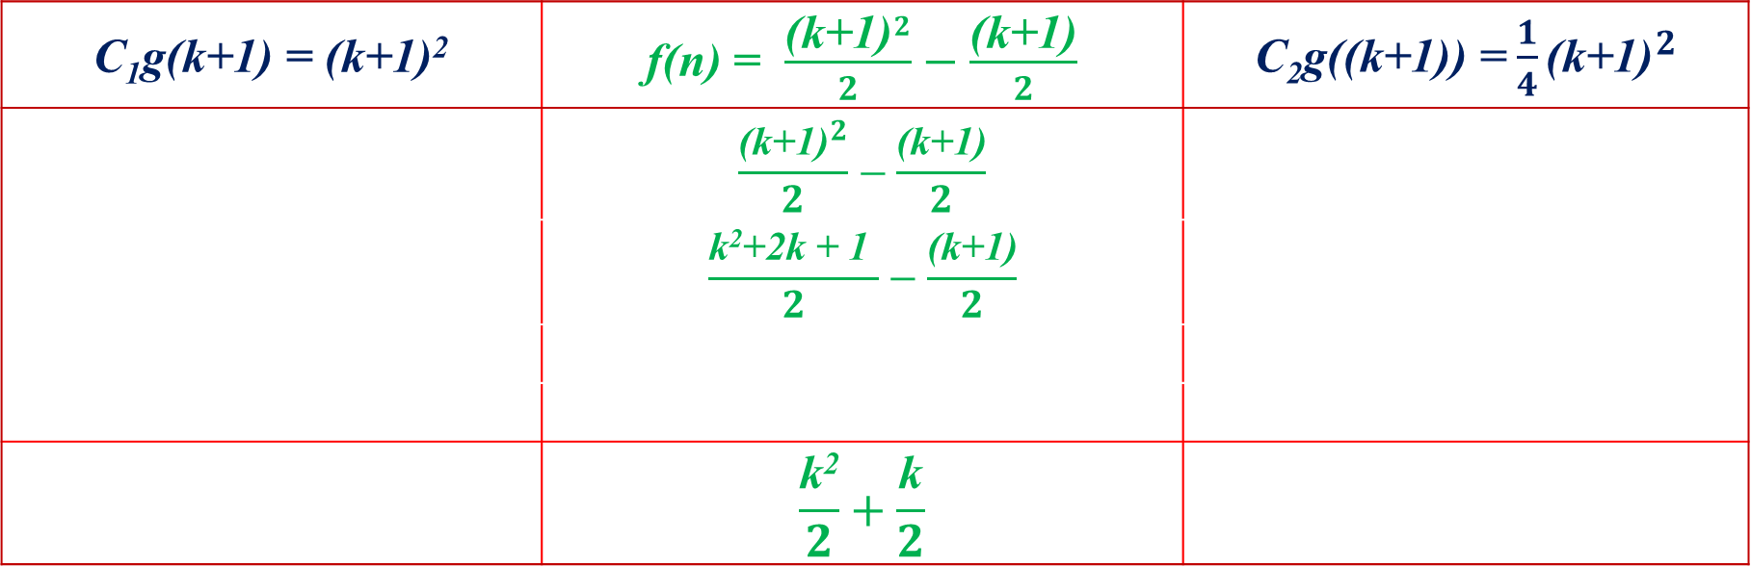
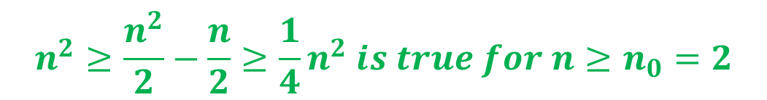
Analyzing Bubble Sort
$$n^{2}≥\frac{n^{2}}{2}−\frac{n}{2}≥\frac{1}{4}n^{2} is true{ for n≥n}_{0}=2$$
We need to prove that:
We use induction method to show:
If it is true for n = k where n ≥ 2, then it is true for n = k+1. Prove that C₁g(k+1) ≥ f(k+1)
C₁g(k+1) = (k+1)² | f(n) = $\frac{{\text{(}\text{k}\text{+1)}}^{2}}{2}−\frac{\text{(}\text{k}\text{+1)}}{2}$ | C₂g((k+1)) =$\frac{1}{4}{\text{(}\text{k}\text{+1)}}^{2}$
 | $$\frac{{\text{(}\text{k}\text{+1)}}^{2}}{2}−\frac{\text{(}\text{k}\text{+1)}}{2}$$
 | $$\frac{\text{k}\text{2}\text{+2}\text{k}\text{ + 1} }{2}−\frac{\text{(}\text{k}\text{+1)}}{2}$$
 | $$\frac{\text{k}\text{2}}{2}+\frac{\text{k}}{2}$$

Slide 69
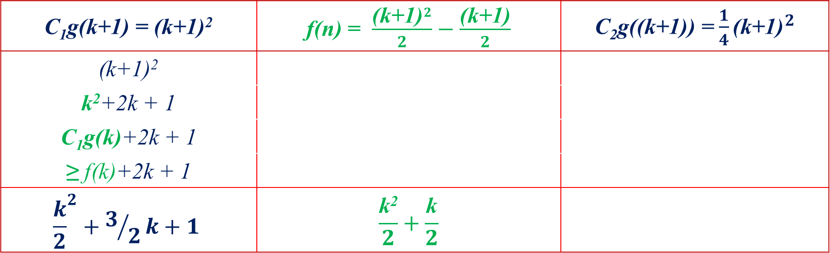
Analyzing Bubble Sort
$$n^{2}≥\frac{n^{2}}{2}−\frac{n}{2}≥\frac{1}{4}n^{2} is true{ for n≥n}_{0}=2$$
We need to prove that:
We use induction method to show:
If it is true for n = k where n ≥ 2, then it is true for n = k+1. Prove that C₁g(k+1) ≥ f(k+1)
C₁g(k+1) = (k+1)² | f(n) = $\frac{{\text{(}\text{k}\text{+1)}}^{2}}{2}−\frac{\text{(}\text{k}\text{+1)}}{2}$ | C₂g((k+1)) =$\frac{1}{4}{\text{(}\text{k}\text{+1)}}^{2}$
(k+1)²
k²+2k + 1
C₁g(k)+2k + 1
≥ f(k)+2k + 1
$${\frac{k}{2}}^{2}+3/2k+1$$ | $$\frac{\text{k}\text{2}}{2}+\frac{\text{k}}{2}$$
≥

Slide 70
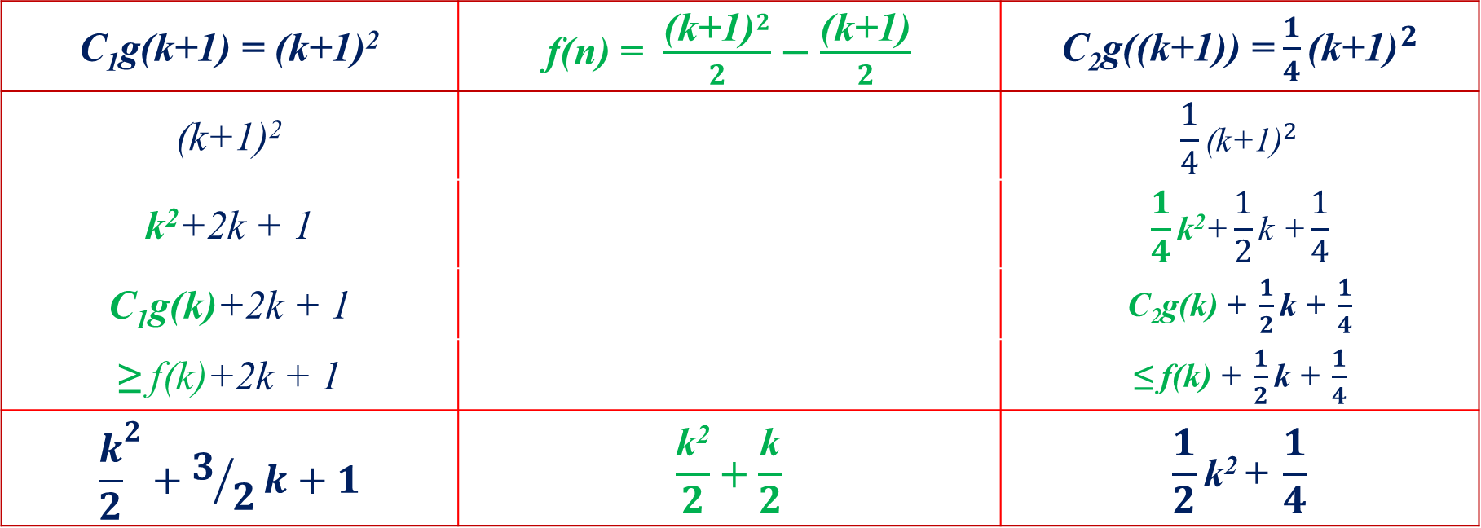
Analyzing Bubble Sort
$$n^{2}≥\frac{n^{2}}{2}−\frac{n}{2}≥\frac{1}{4}n^{2} is true{ for n≥n}_{0}=2$$
We need to prove that:
We use induction method to show:
If it is true for n = k where n ≥ 2, then it is true for n = k+1. Prove that C₁g(k+1) ≥ f(k+1)
C₁g(k+1) = (k+1)² | f(n) = $\frac{{\text{(}\text{k}\text{+1)}}^{2}}{2}−\frac{\text{(}\text{k}\text{+1)}}{2}$ | C₂g((k+1)) =$\frac{1}{4}{\text{(}\text{k}\text{+1)}}^{2}$
(k+1)² |  | $$\frac{1}{4}{\text{(}\text{k}\text{+1)}}^{2}$$
k²+2k + 1 |  | $$\frac{1}{4}\text{k}\text{2}\text{+}\frac{1}{2}\text{k}\text{ +}\frac{1}{4}$$
C₁g(k)+2k + 1 |  | C₂g(k) $\text{+} \frac{1}{2}\text{k}\text{ +} \frac{1}{4}$
≥ f(k)+2k + 1 |  | ≤ f(k) $\text{+} \frac{1}{2}\text{k}\text{ +} \frac{1}{4}$
$${\frac{k}{2}}^{2}+3/2k+1$$ | $$\frac{\text{k}\text{2}}{2}+\frac{\text{k}}{2}$$ | $$\frac{1}{2}\text{k}\text{2 }\text{+} \frac{1}{4}$$
≥
≥

Slide 71
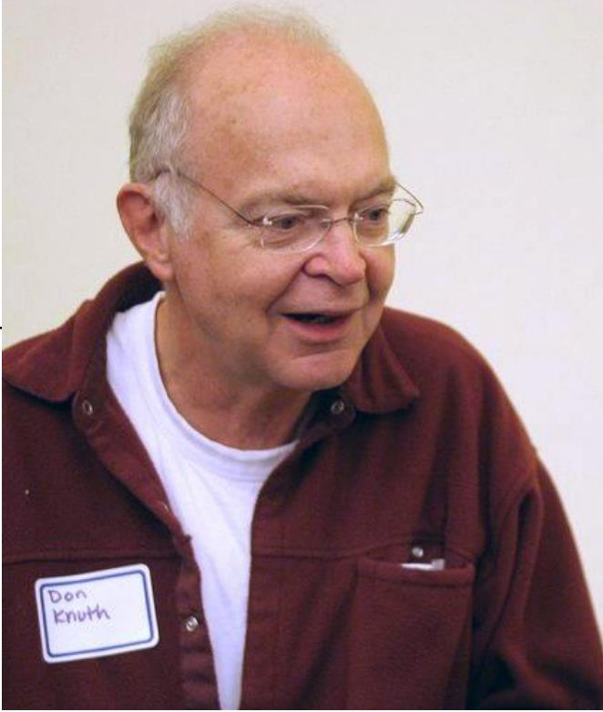
Analyzing Bubble Sort
The running time of Bubble Sort is: Θ(n²)
“The bubble sort seems to have nothing to recommend it, except a catchy name and the fact that it leads to some interesting theoretical problems.”
Don Knuth

Slide 72
Theorem
For any two functions f(n) and g(n),
we have f(n) = Θ(g(n))
if and only if f(n) = O(g(n)) and f(n) = Ω(g(n))

Slide 73

Example 0: Asymptotic notation
(a)
(b)
(c)
Θ(g(n))
O(g(n))
Ω(g(n))

Slide 74
Example 1.
Show that
We must find c₁ and c₂ such that
Dividing bothsides by n² yields
For

Slide 75
Example 2.
Because :

Slide 76


Example 3: $3n^{2}−100n+6=O\left(n^{2}\right)$
$$3n^{2}−100n+6=O\left(n^{2}\right)$$
$$3n^{2}−100n+6=O\left(n^{3}\right)$$
$$3n^{2}−100n+6≠O\left(n\right)$$
$$3n^{2}−100n+6=Ω\left(n^{2}\right)$$
$$3n^{2}−100n+6≠Ω\left(n^{3}\right)$$
$$3n^{2}−100n+6=Ω\left(n\right)$$
$$3n^{2}−100n+6=Θ\left(n^{2}\right)$$
$$3n^{2}−100n+6≠Θ\left(n^{3}\right)$$
$$3n^{2}−100n+6≠Θ(n)$$
$$\text{since} \text{for} c=3,3n^{2}>3n^{2}−100n+6$$
$$\text{since} \text{for} c=1,n^{3}>3n^{2}−100n+6 \text{when} n>3$$
$$\text{since} \text{for} \text{any} c,cn<3n^{2}\text{when} n>c$$
$$\text{since} \text{for} c=2,2n^{2}<3n^{2}−100n+6 \text{when} n>100$$
$$\text{since} \text{for} c=3,3n^{2}−100n+6<n^{3}\text{when} n>3$$
$$\text{since} \text{for} \text{any} c,cn<3n^{2}−100n+6\text{when} n>100$$
$$\text{since} \text{both} O \text{and} Ω \text{apply}\text{.}$$
$$\text{since} \text{only} O \text{applies}\text{.}$$
$$\text{since} \text{only} Ω \text{applies}\text{.}$$

Slide 77


Example 4.1
for (i = 1 ; i < n ; i = i*2)
print(i);
i:
1
2
2²
2³
…
2^{k-1}
2^{k}
Loop terminates when i ≥ n
2^{k} = n
$k=log{n}$
i:
1
* 2
* 2
* 2 *
…
* 2
= n
2^{k} = n
$k=log{n}$

Slide 78



Example 4.1
for (i = 1 ; i < 8 ; I = i*2)
print(i);
for (i = 1 ; i < 10 ; I = i*2)
print(i);
i:
1
2
2²
2³
i:
1
2
2²
2³
2⁴
2^{k} = 8
2^{k} = 10
$k=log{8}$
3
$k=log{10}$
4
k = 3
k = 3.2
⎾$\log{n}$⏋

Slide 79
Standard notations and common functions
Floors and ceilings:

Slide 80
Estimating Running Time
Suppose an algorithm executes f(n) primitive operations in the worst case. Define:
a = Time taken by the fastest primitive operation
b = Time taken by the slowest primitive operation
Let T(n) be worst-case time of the algorithm. Then af(n) ≤ T(n) ≤ bf(n)
Hence, the running time T(n) is bounded by two linear functions
Changing the hardware/ software environment
Affects T(n) by a constant factor, but
Does not alter the growth rate of T(n)

Slide 81
Constant Factors
Growth rate is not affected by
Constant factors or
Lower-order terms
Examples
10²n + 10⁵ is a linear function
10⁵n² + 10⁸n is a quadratic function

Slide 82
More Big-Oh Examples
7n-2 is O(n)
need c > 0 and n₀ ≥ 1 such that 7n-2 ≤ cn for n ≥ n₀
this is true for c = 7 and n₀ = 1
7n-2
3n³ + 20n² + 5 is O(n³)
need c > 0 and n₀ ≥ 1 such that 3n³ + 20n² + 5 ≤ cn³ for n ≥ n₀
this is true for c = 4 and n₀ = 21
3n3 + 20n2 + 5
3logn + 5 is O(logn)
need c > 0 and n0 ≥ 1 such that 3logn + 5 ≤ clog n for n ≥ n₀
this is true for c = 8 and n₀ = 2
3log n + 5

Slide 83
Big-Oh and Growth Rate
The big-Oh notation gives an upper bound on the growth rate of a function
The statement “f(n) is O(g(n))” means that the growth rate of f(n) is no more than the growth rate of g(n)
We can use the big-Oh notation to rank functions according to their growth rate
 | f(n) is O(g(n)) | g(n) is O(f(n))
g(n) grows more | Yes | No
f(n) grows more | No | Yes
Same growth | Yes | Yes

Slide 84
Big-Oh Rules
If is f(n) a polynomial of degree d, then f(n) is O(n^{d}), i.e.,
Drop lower-order terms
Drop constant factors
Use the smallest possible class of functions
Say “2n is O(n)” instead of “2n is O(n²)”
Use the simplest expression of the class
Say “3n + 5 is O(n)” instead of “3n + 5 is O(3n)”

Slide 85

Example: Computing Prefix Averages
We further illustrate asymptotic analysis with two algorithms for prefix averages
The i-th prefix average of an array X is average of the first (i + 1) elements of X:
$$A[i]=\frac{x\left[0\right]+x\left[1\right]+ …+x[i]}{i+1}$$
Computing the array A of prefix averages of another array X has applications to financial analysis

Slide 86

Prefix Averages (Quadratic)
The following algorithm computes prefix averages
Algorithm prefixAverages1(X, n)
Input array X of n integers
Output array A of prefix averages of X
A ← new array of n integers
for i ← 0 to n − 1 do
s ← X[0]
for j ← 1 to i do
s ← s + X[j]
A[i] ← s / (i + 1)
return A
#operations
n
n
n
1 + 2 + …+ (n − 1)
1 + 2 + …+ (n − 1)
n
1
$$\frac{n(n+1)}{2}=\frac{n2+n}{2}$$
The running time of prefixAverages1 is O(n²)

Slide 87

Prefix Averages (Linear)
The following algorithm computes prefix averages in linear time by keeping a running sum
Algorithm prefixAverages2(X, n)
Input array X of n integers
Output array A of prefix averages of X
A ← new array of n integers
s ← 0
for i ← 0 to n − 1 do
s ← s + X[i]
A[i] ← s / (i + 1)
return A
#operations
n
1
n
n
n
1
$$=n+1+n+n+n+1$$
$$=4n+4$$
Algorithm prefixAverages2 runs in O(n) time

Slide 88
Intuition for Asymptotic Notation
Big-Oh
f(n) is O(g(n)) if f(n) is asymptotically less than or equal to g(n)
big-Omega
f(n) is Ω(g(n)) if f(n) is asymptotically greater than or equal to g(n)
big-Theta
f(n) is Θ(g(n)) if f(n) is asymptotically equal to g(n)

Slide 89
Examples
f(n) is Ω(g(n)) if there is a constant c > 0 and an integer constant n₀ ≥ 1 such that f(n) ≥ cg(n) for n ≥ n₀
let c = 5 and n₀ = 1
5n² is Ω(n²)
f(n) is Ω(g(n)) if there is a constant c > 0 and an integer constant n₀ ≥ 1 such that f(n) ≥ cg(n) for n ≥ n₀
let c = 1 and n₀ = 1
5n² is Ω(n)
f(n) is Θ(g(n)) if it is Ω(n²) and O(n²). We have already seen the former, for the latter recall that f(n) is O(g(n)) if there is a constant c > 0 and an integer constant n₀ ≥ 1 such that f(n) < cg(n) for n ≥ n₀
Let c = 5 and n₀ = 1
5n² is Θ(n²)

Slide 90
Standard notations and common functions
n! = O(n^{n})
n! = ω(2^{n})
lg(n!) = Θ(n lg n)

